Slide 1
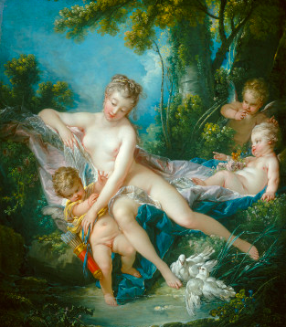
Parlour minus 1 visible only in trailer
François Boucher, "The Bath of Venus," (1751) National Gallery of Art (Washington), Chester Dale Collection 1943.7.2.

Slide 2
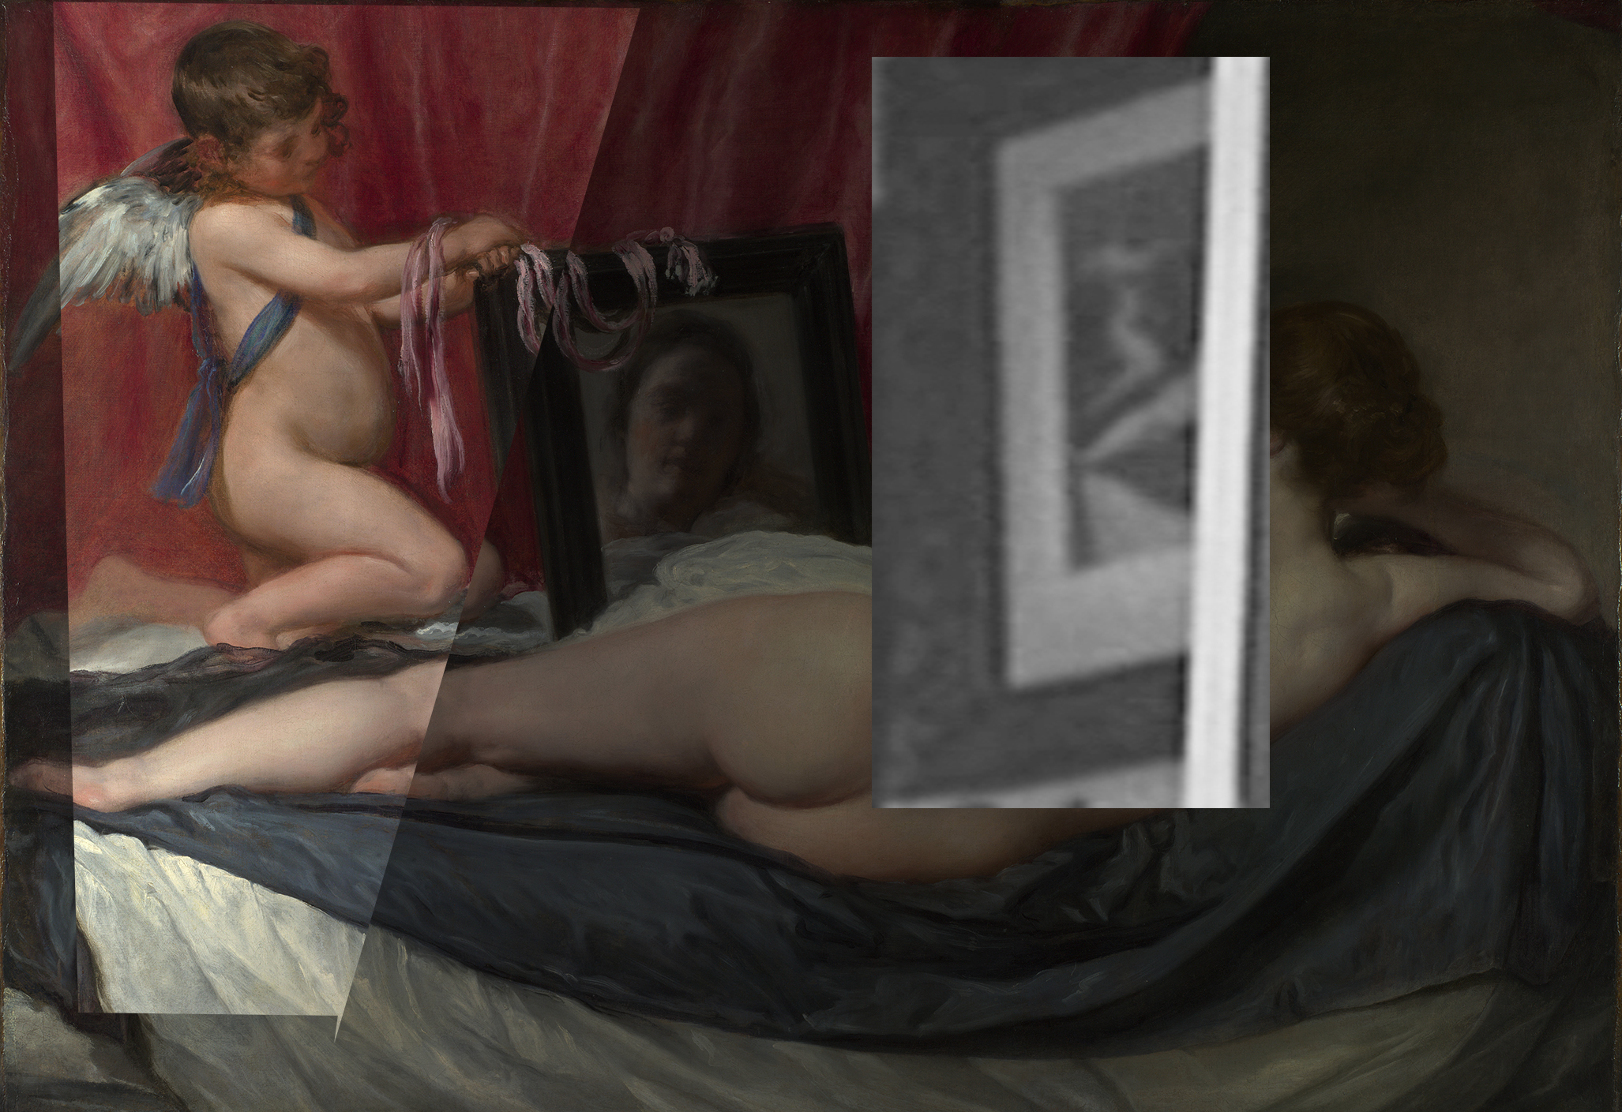
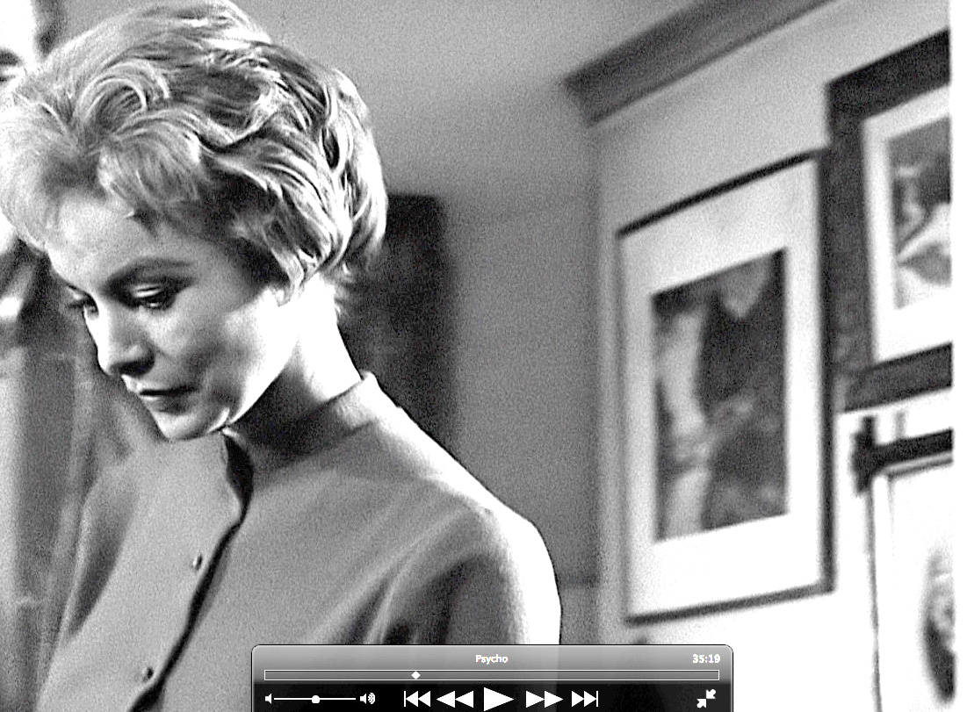
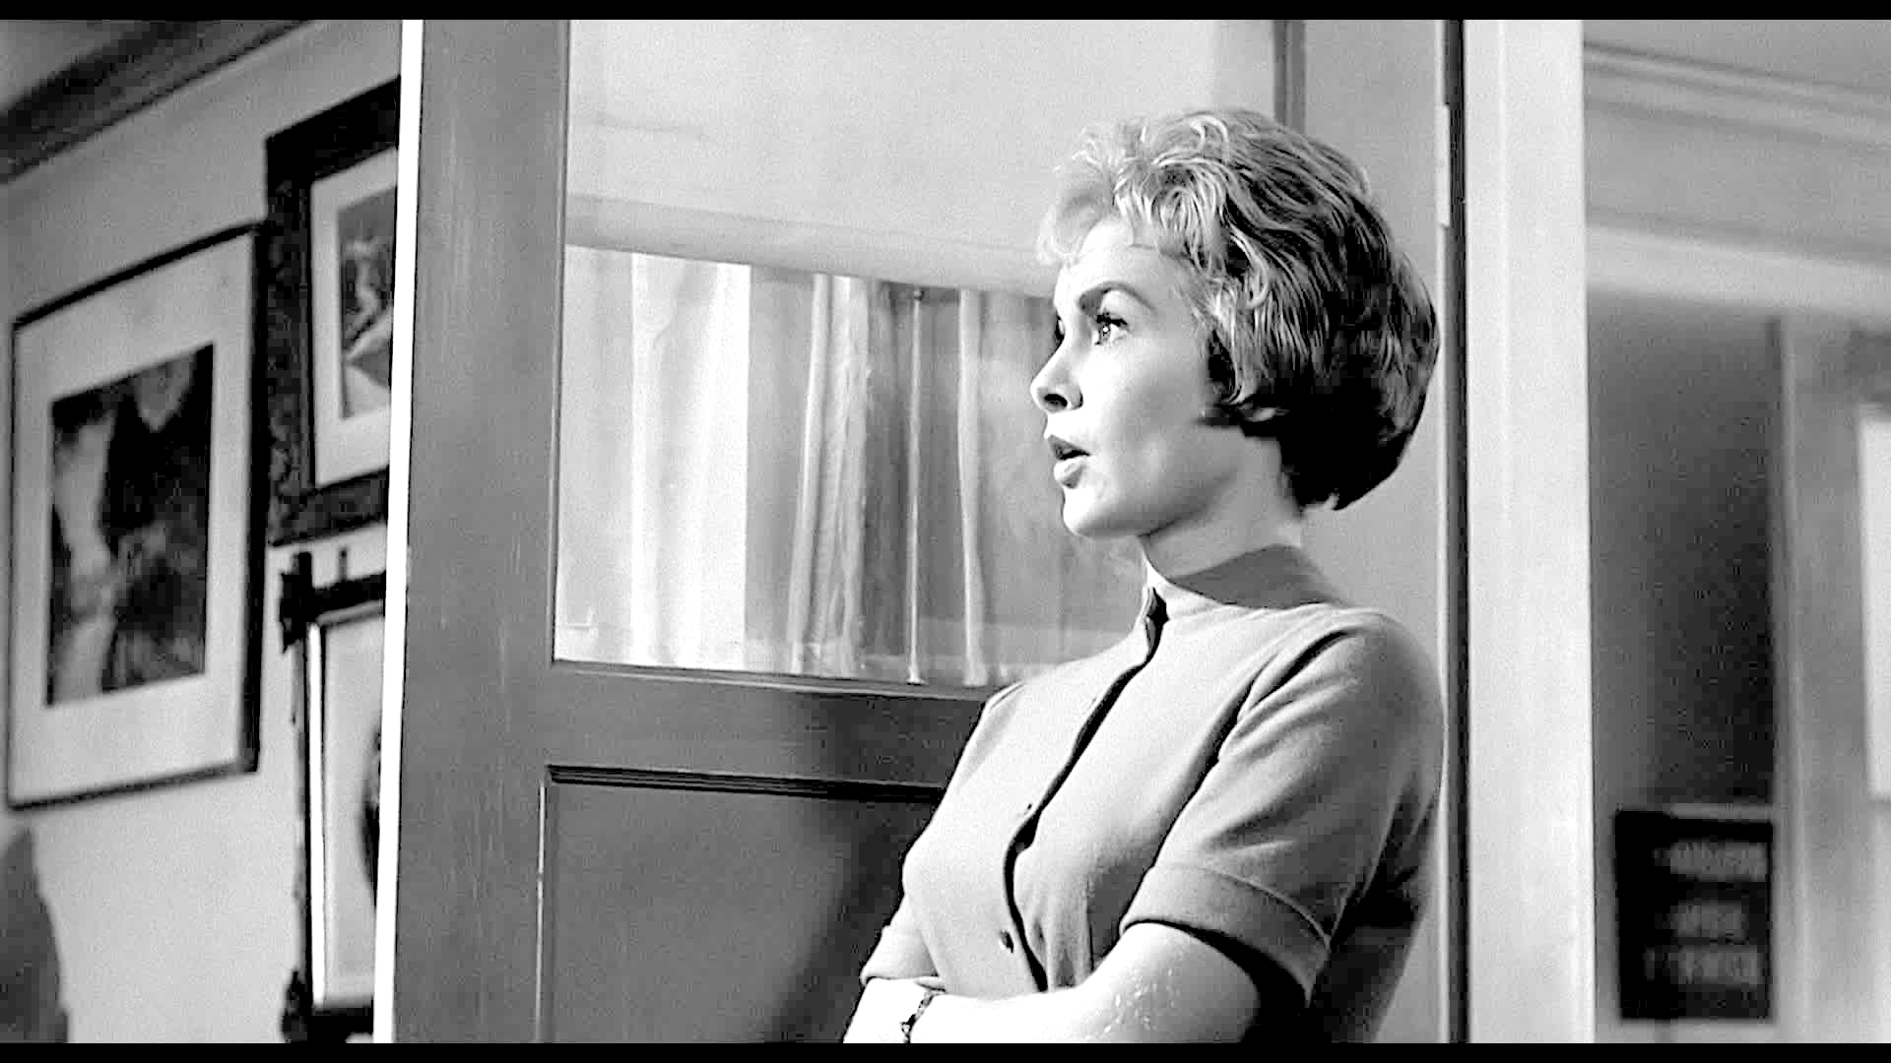
Parlour 1 00.35.16.21
Diego Velázquez, "The Toilet of Venus (The Rokeby Venus)," (1647-51), National Gallery NG 2057

Slide 3
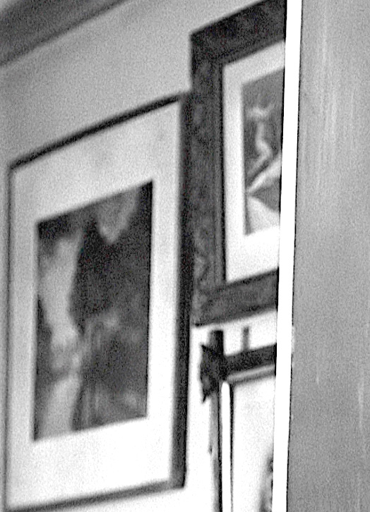
Parlour 3 00.35.16.21 00.35.19.00. 00.35.20.05 at 00.35.19.13 Marion is framed by rokeby Venus and this
landscape with ruined arch

Slide 4
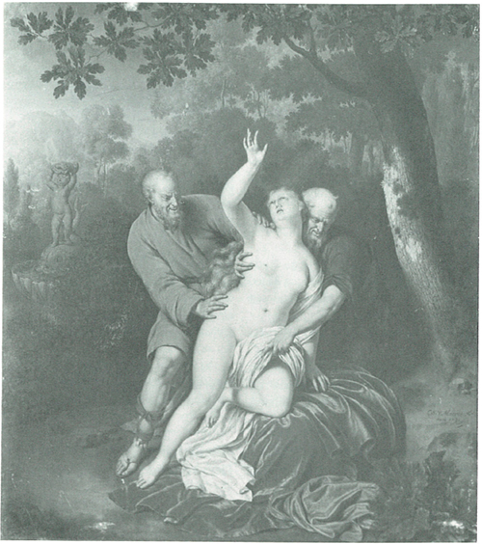
Parlour 5 00.35.16.21
Willem Van Mieris “Suzanne et les Viellards” (1731) (var. attributed to Frans Van Mieris the Elder) Perpignan, Musée Hyacinthe Rigaud (stolen 1972); cf. Musées Nationaux Récupération MNR 552.

Slide 5
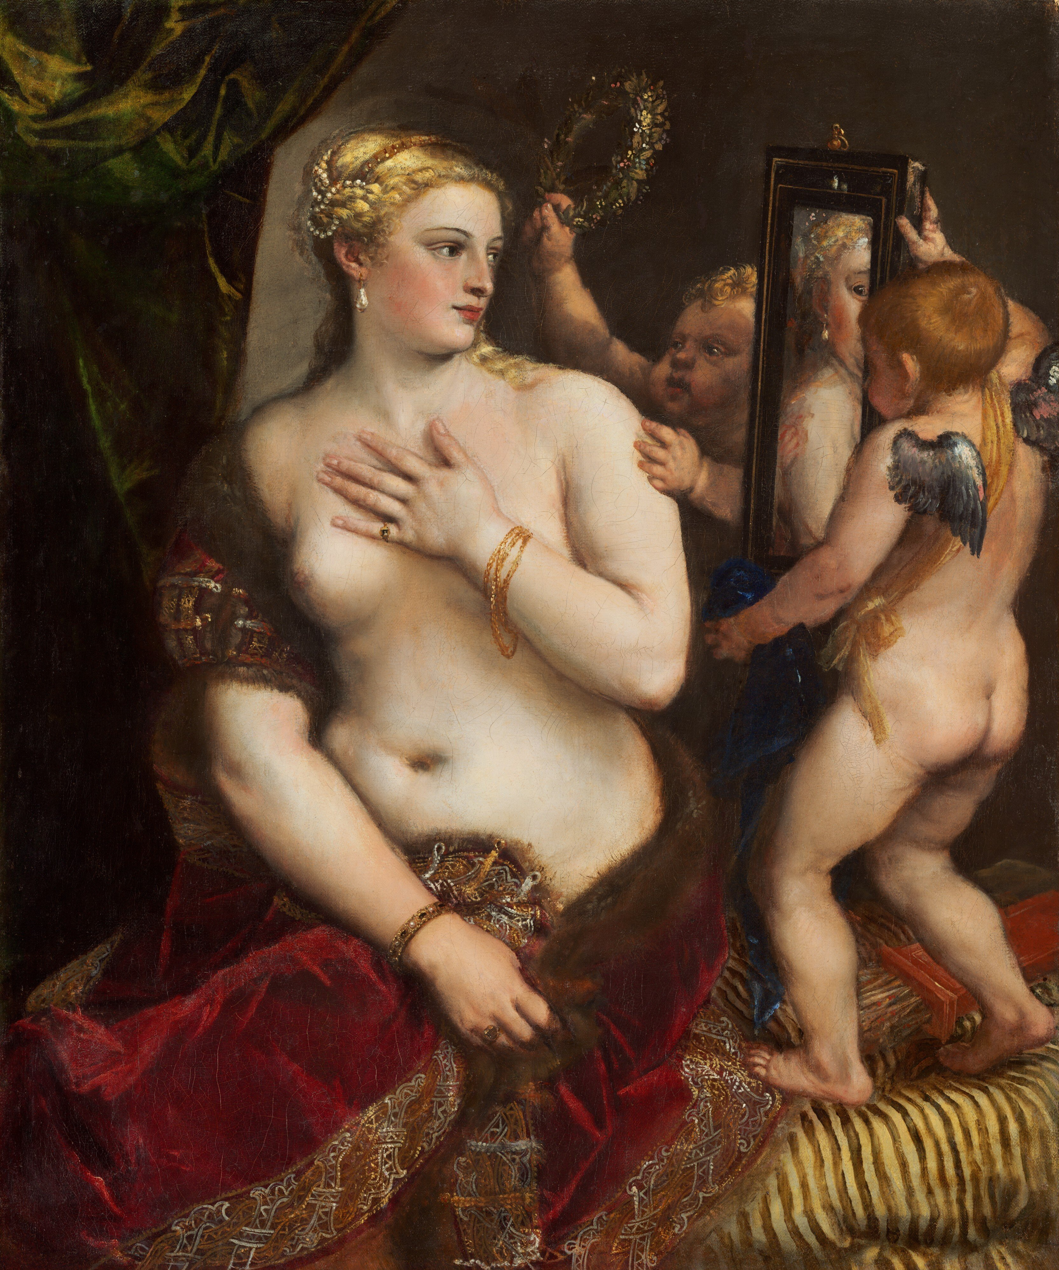
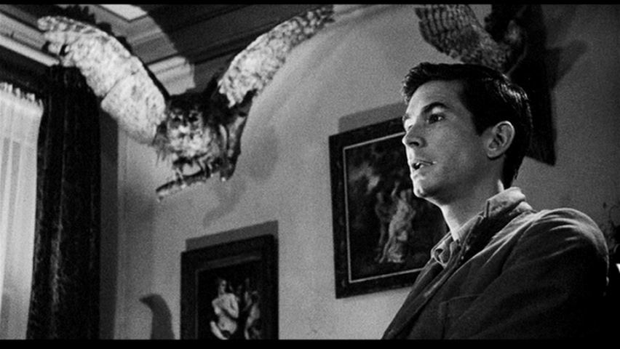
Parlour 6 00.35.16.21
Titian, Venus with a Mirror, c. 1555; National Gallery of Art, Andrew W. Mellon Collection 1937.1.34

Slide 6
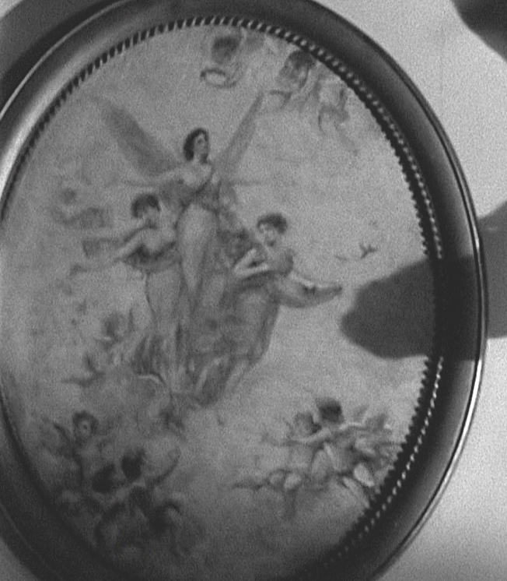
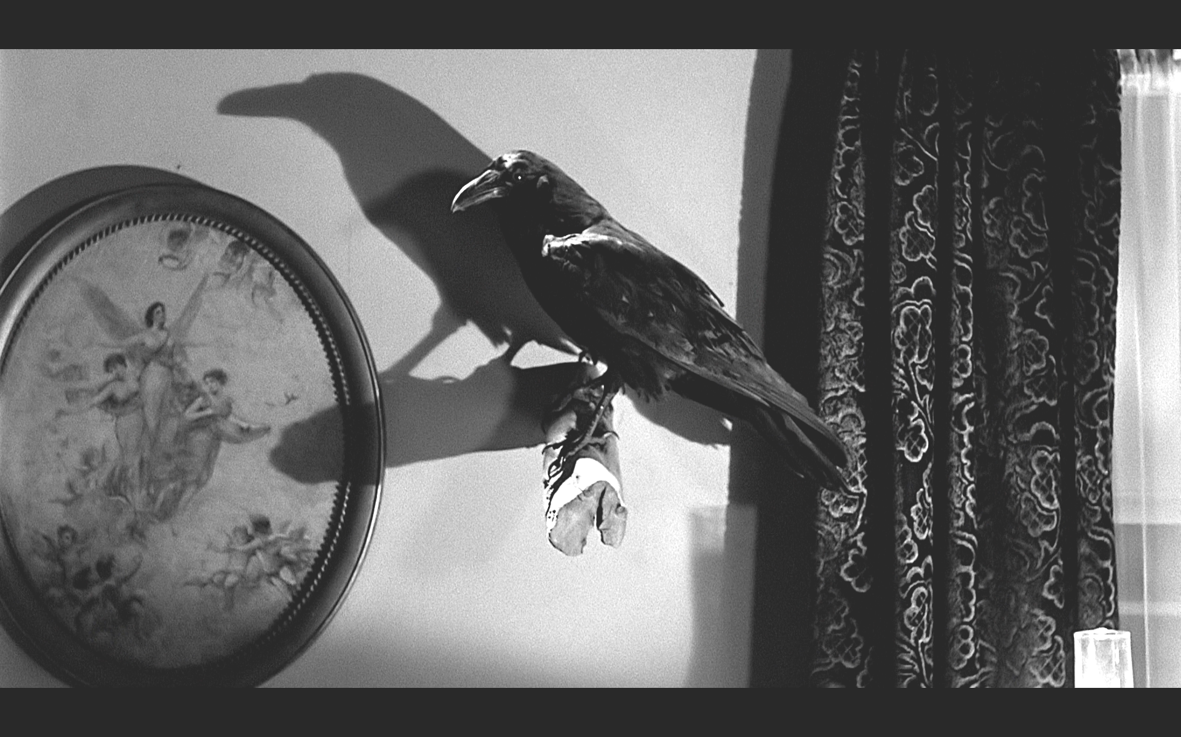
Parlour 7
oval framed ascension of the Blessed Virgin

Slide 7
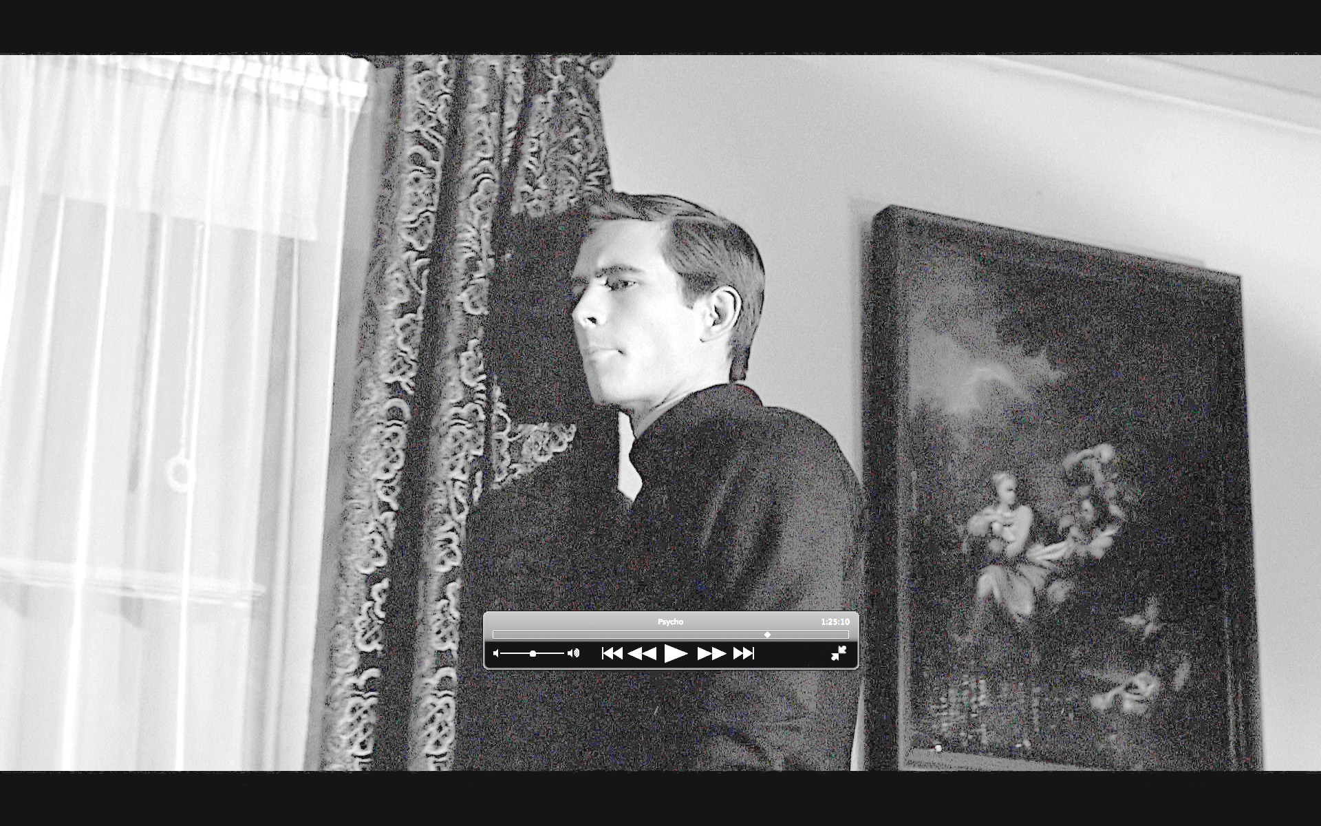
Parlour 8 00.44.06.03. 01.25.09.23
Sure looks like a Susannah, indeed much like Pompeo Batoni's

Slide 8
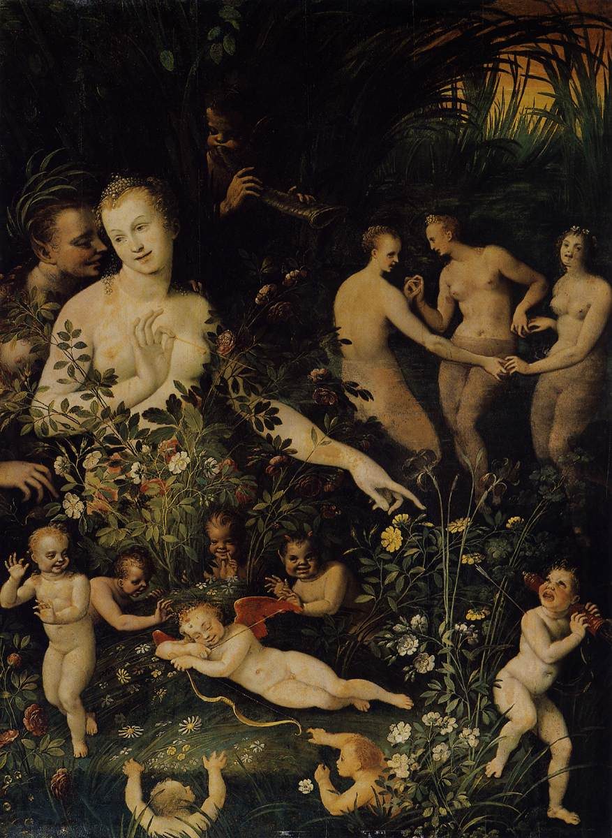
Parlour 9 1.15.38.10
Fontainebleau School, Mythological Allegory, ca. 1580, Museé du Louvre, R.F. 1946-22.
To the right of the doorway of the Parlour. The image shows up quickly when Norman turns off the light and exits.

Slide 9
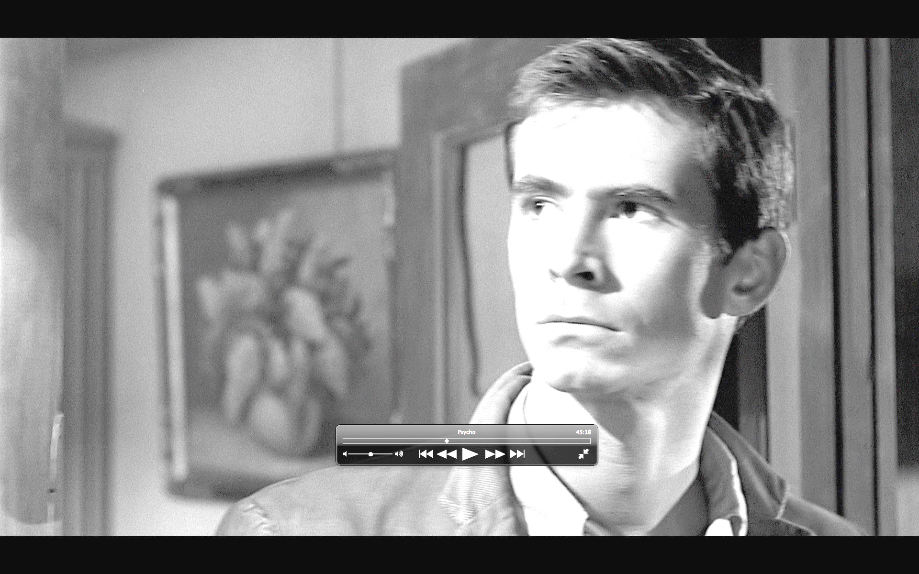
Reception 00.45.33.23
still life of flowers in a vase

Slide 10
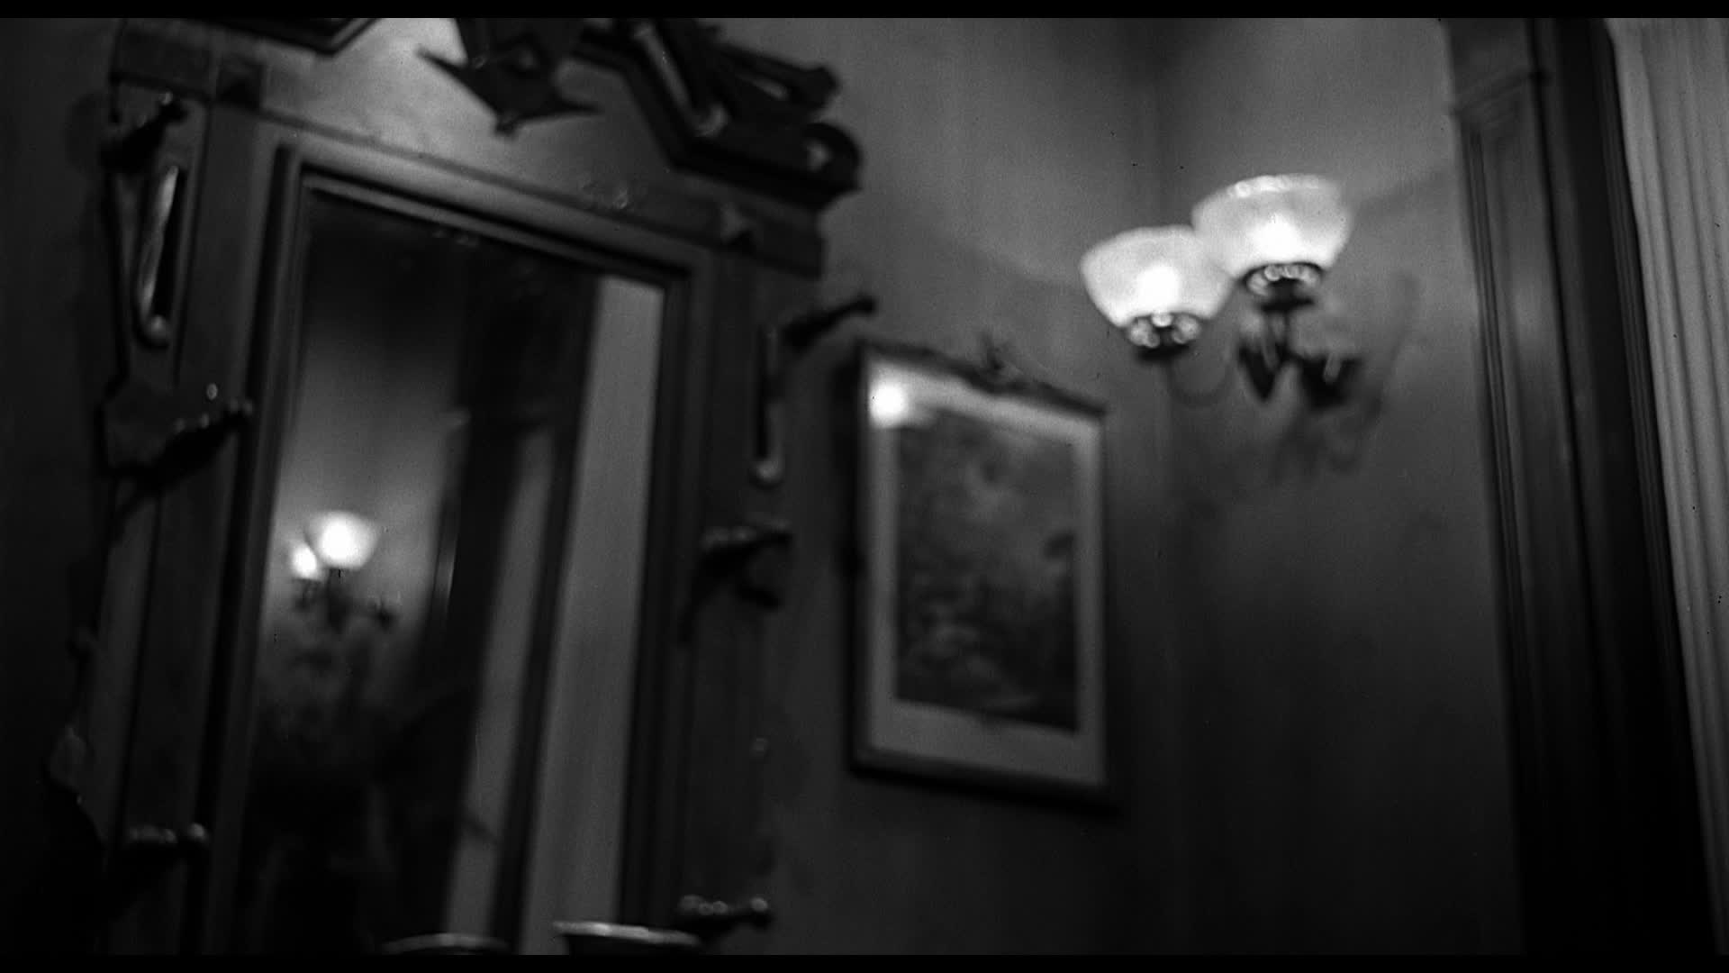
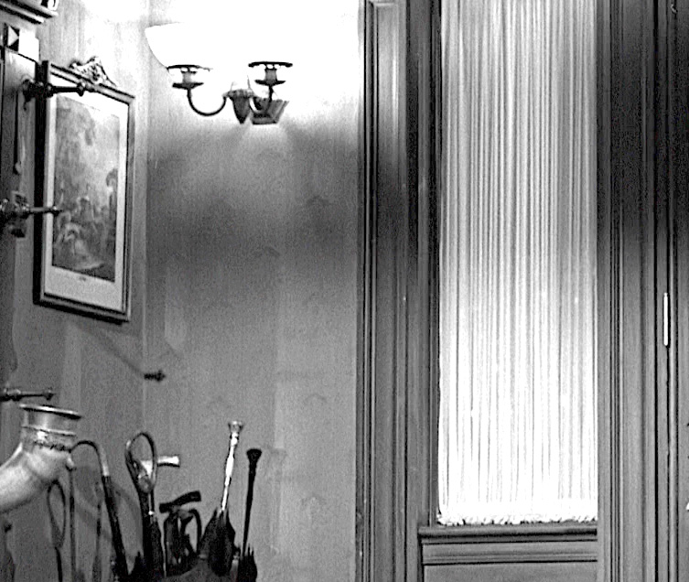
Bates Entry; Arbogast Witness 00.45.33.23

Slide 11
Bates Entry; blurry painting 1.25.29.21 but it's always blurred

Slide 12
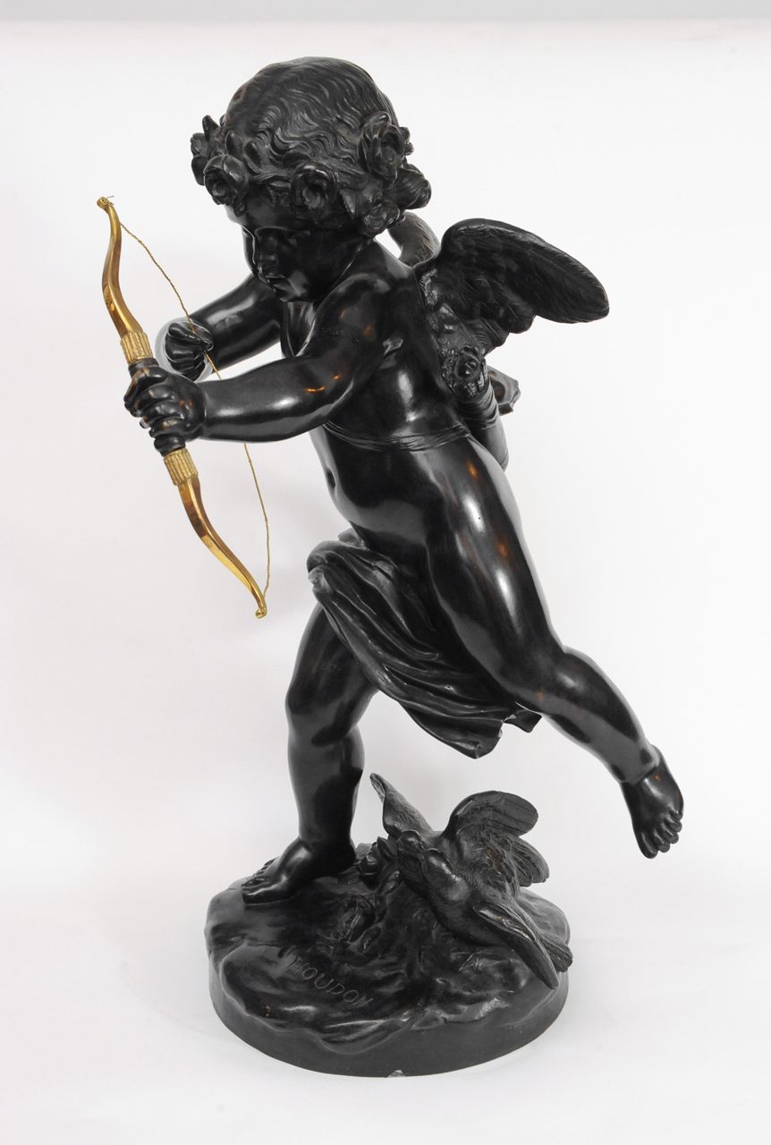
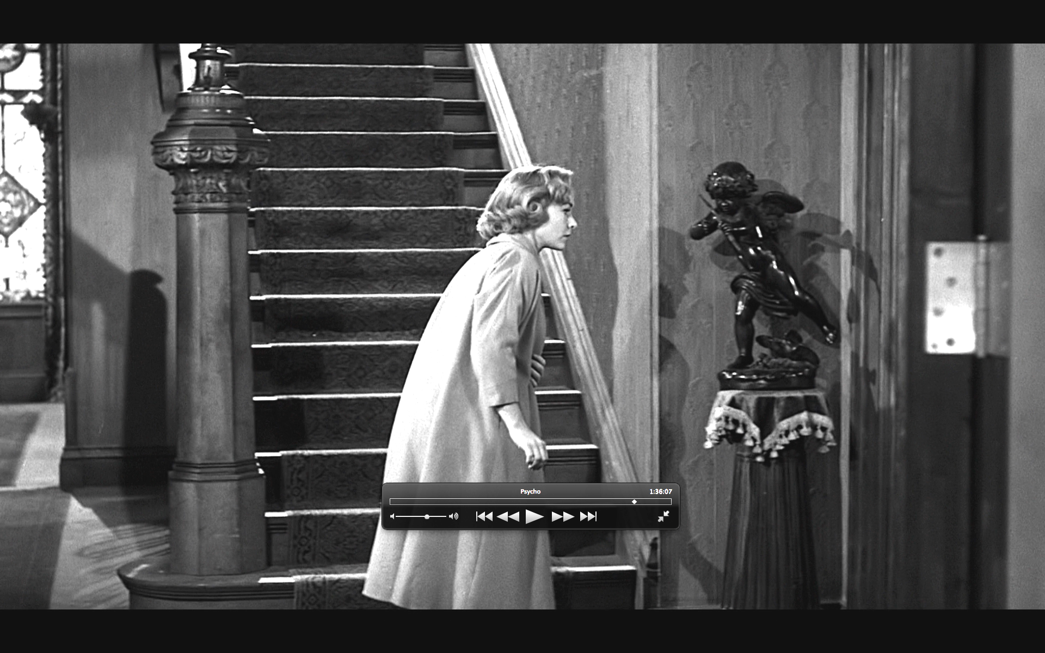
Bates Entry; Eros statuette Arbogast, Lila, trailer
attributed to Houdon

Slide 13
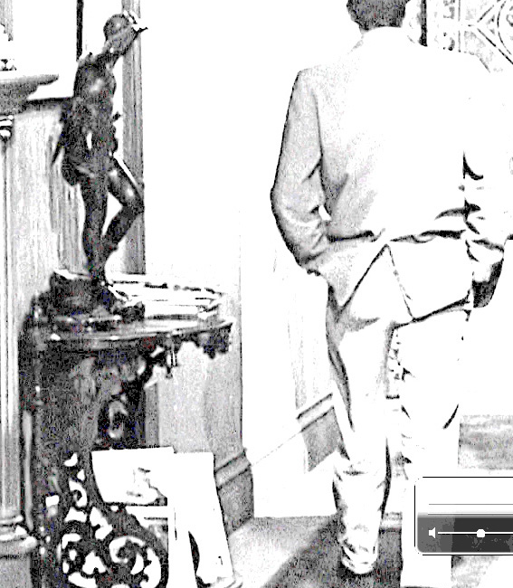
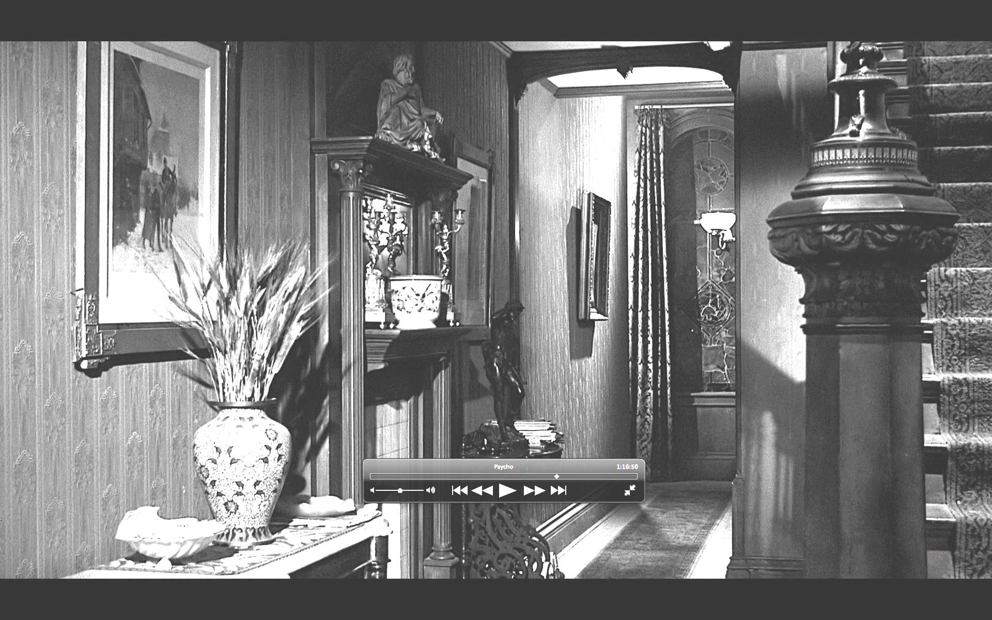
Bates Entry; bronze statuette left 00.45.37.18. 0.45.45.19 Is it different at 1.16.49.10?
youthful searching male; Also in trailer. Left leg bent in contraposto. Pose similar to Thomas Crawford's Orpheus, but this lacks the cerberus and is not striding nearly as determinedly. Also looks like the same pose in Burne-Jones' Perseus; how about the Watts Physical Energy equestrian statue shielding eyes?

Slide 14
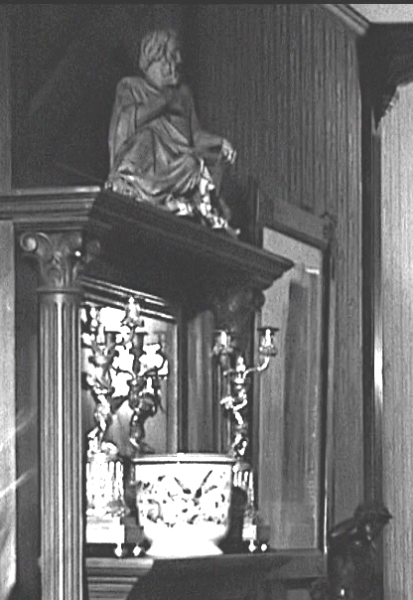
Bates Entry; sculpted minature 00.45.37.18. 00.45.45.19. 0.45.49.16
seated or reclining divinity in robes

Slide 15
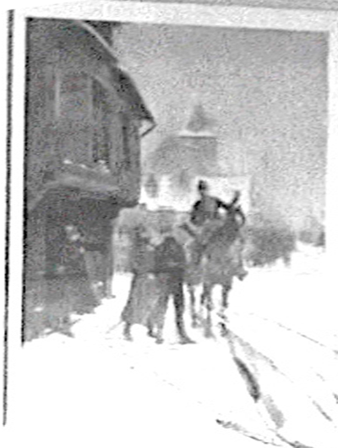
Bates Entry left painting 00.45.37.18. 00.45.45.19. 0.45.49.16
two pedestrians addressing a man on horseback in a town

Slide 16
Bates staircase 1.16.52.14, 1.26.00.23, 1.26.04.20, 1.26.05.12, 1.26.06.22, w/ Houdon Cupid 1.36.46.01, also Trailer big clear shot.
swirling maenad or Verlet’s Orpheus painted

Slide 17
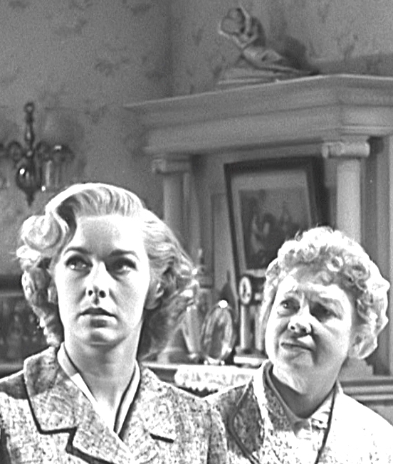
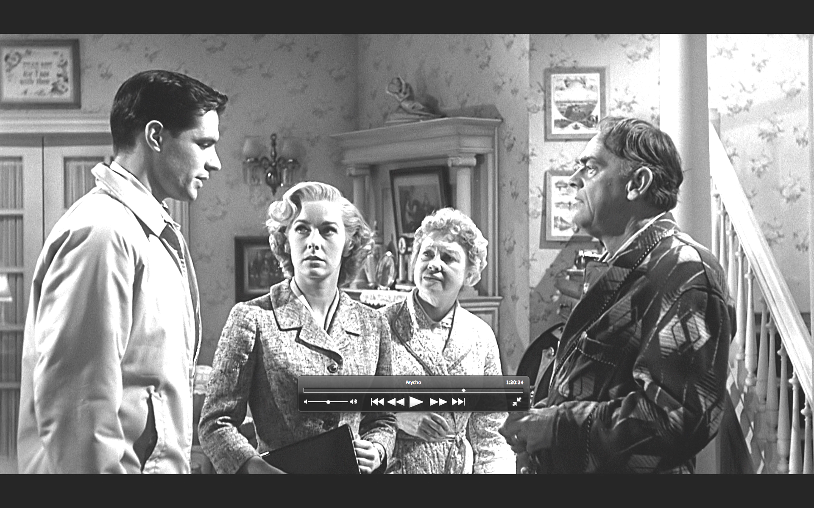
Chambers Home, mantle mini 1.20.35.04
miniature of Canova’s Cupid and Psyche (no wings)

Slide 18
Chambers Home, stairway bust 1.22.05.20 (6 glimpses)

Slide 19
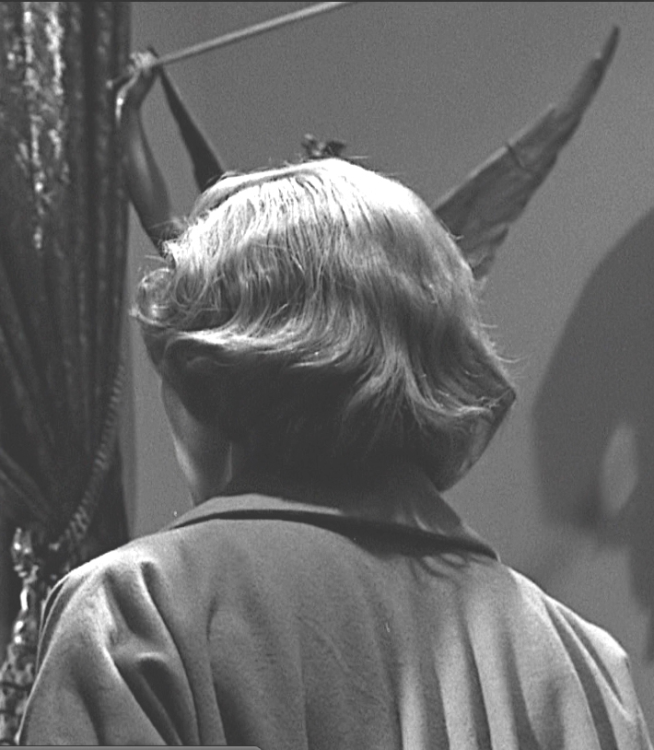
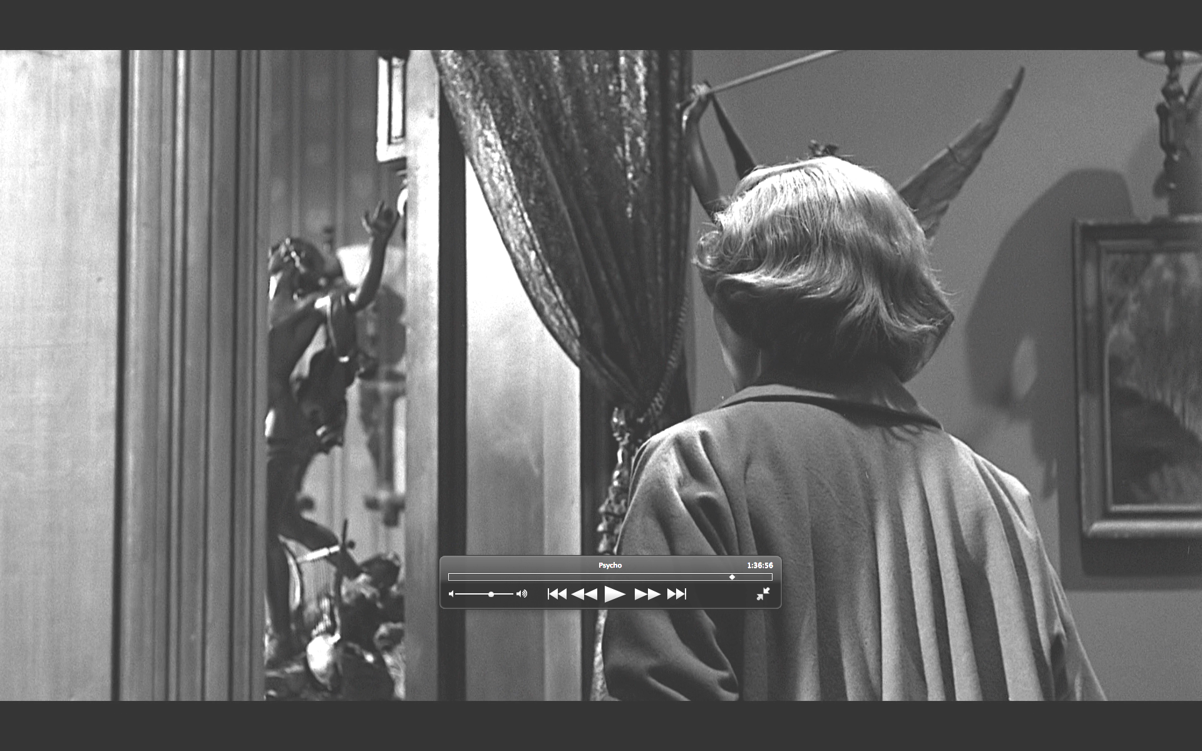
Mrs Bates Bedroom, vestibule sculpture 1.36.56.03
Not Emmanuel Frémiet, St. Michel. It’s that strange “right” hand. Keep checking Canova.

Slide 20
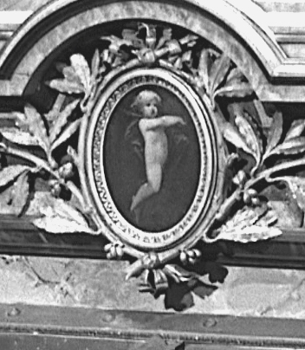
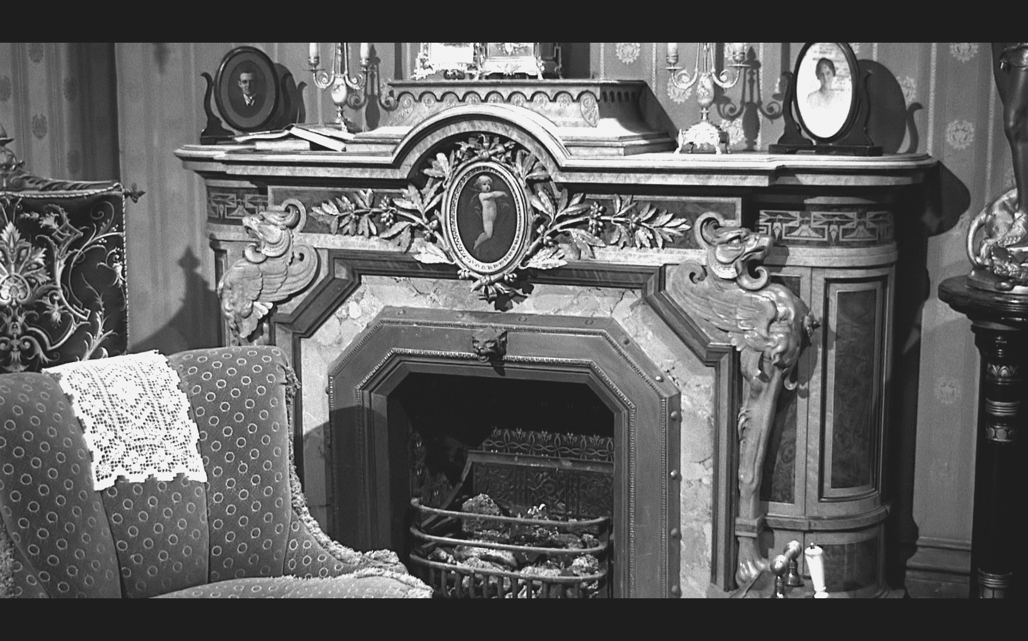
Mrs Bates Bedroom, mantlepiece Eros 1.37.16.00
Diego Velázquez, "The Toilet of Venus (The Rokeby Venus)," (1647-51), National Gallery NG 2057

Slide 21
Mrs Bates Bedroom trailer only
trailer only? Bedroom shown full on with verlet: big painting over the mantle

Slide 22
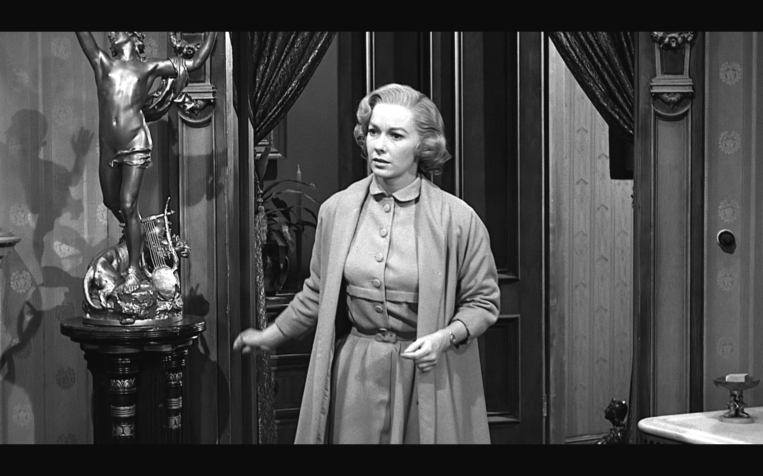
Mrs Bates Bedroom 00.35.16.21
miniature copy of Raoul-Charles Verlet, “La Doleur d’Orphée” destroyed 1943

Slide 23
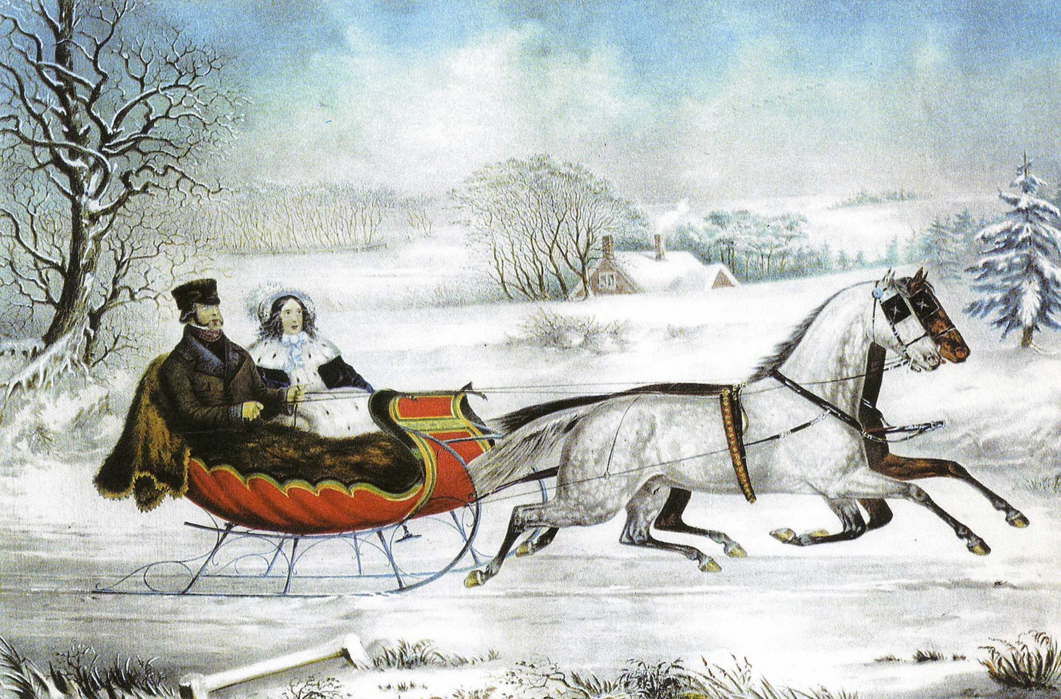
Cabin 10 00.35.16.21
Nathaniel Currier (w/ Otto Knirsch), lithograph, “The Road, — Winter” 1853
H.T. Peters, Currier & Ives: printmakers to the American people (Garden City, 1943), Plate 1. Note that the United States Postal Service printed a miniature version of The Road, — Winter on its 10¢ postage stamp in 1974.

Slide 24
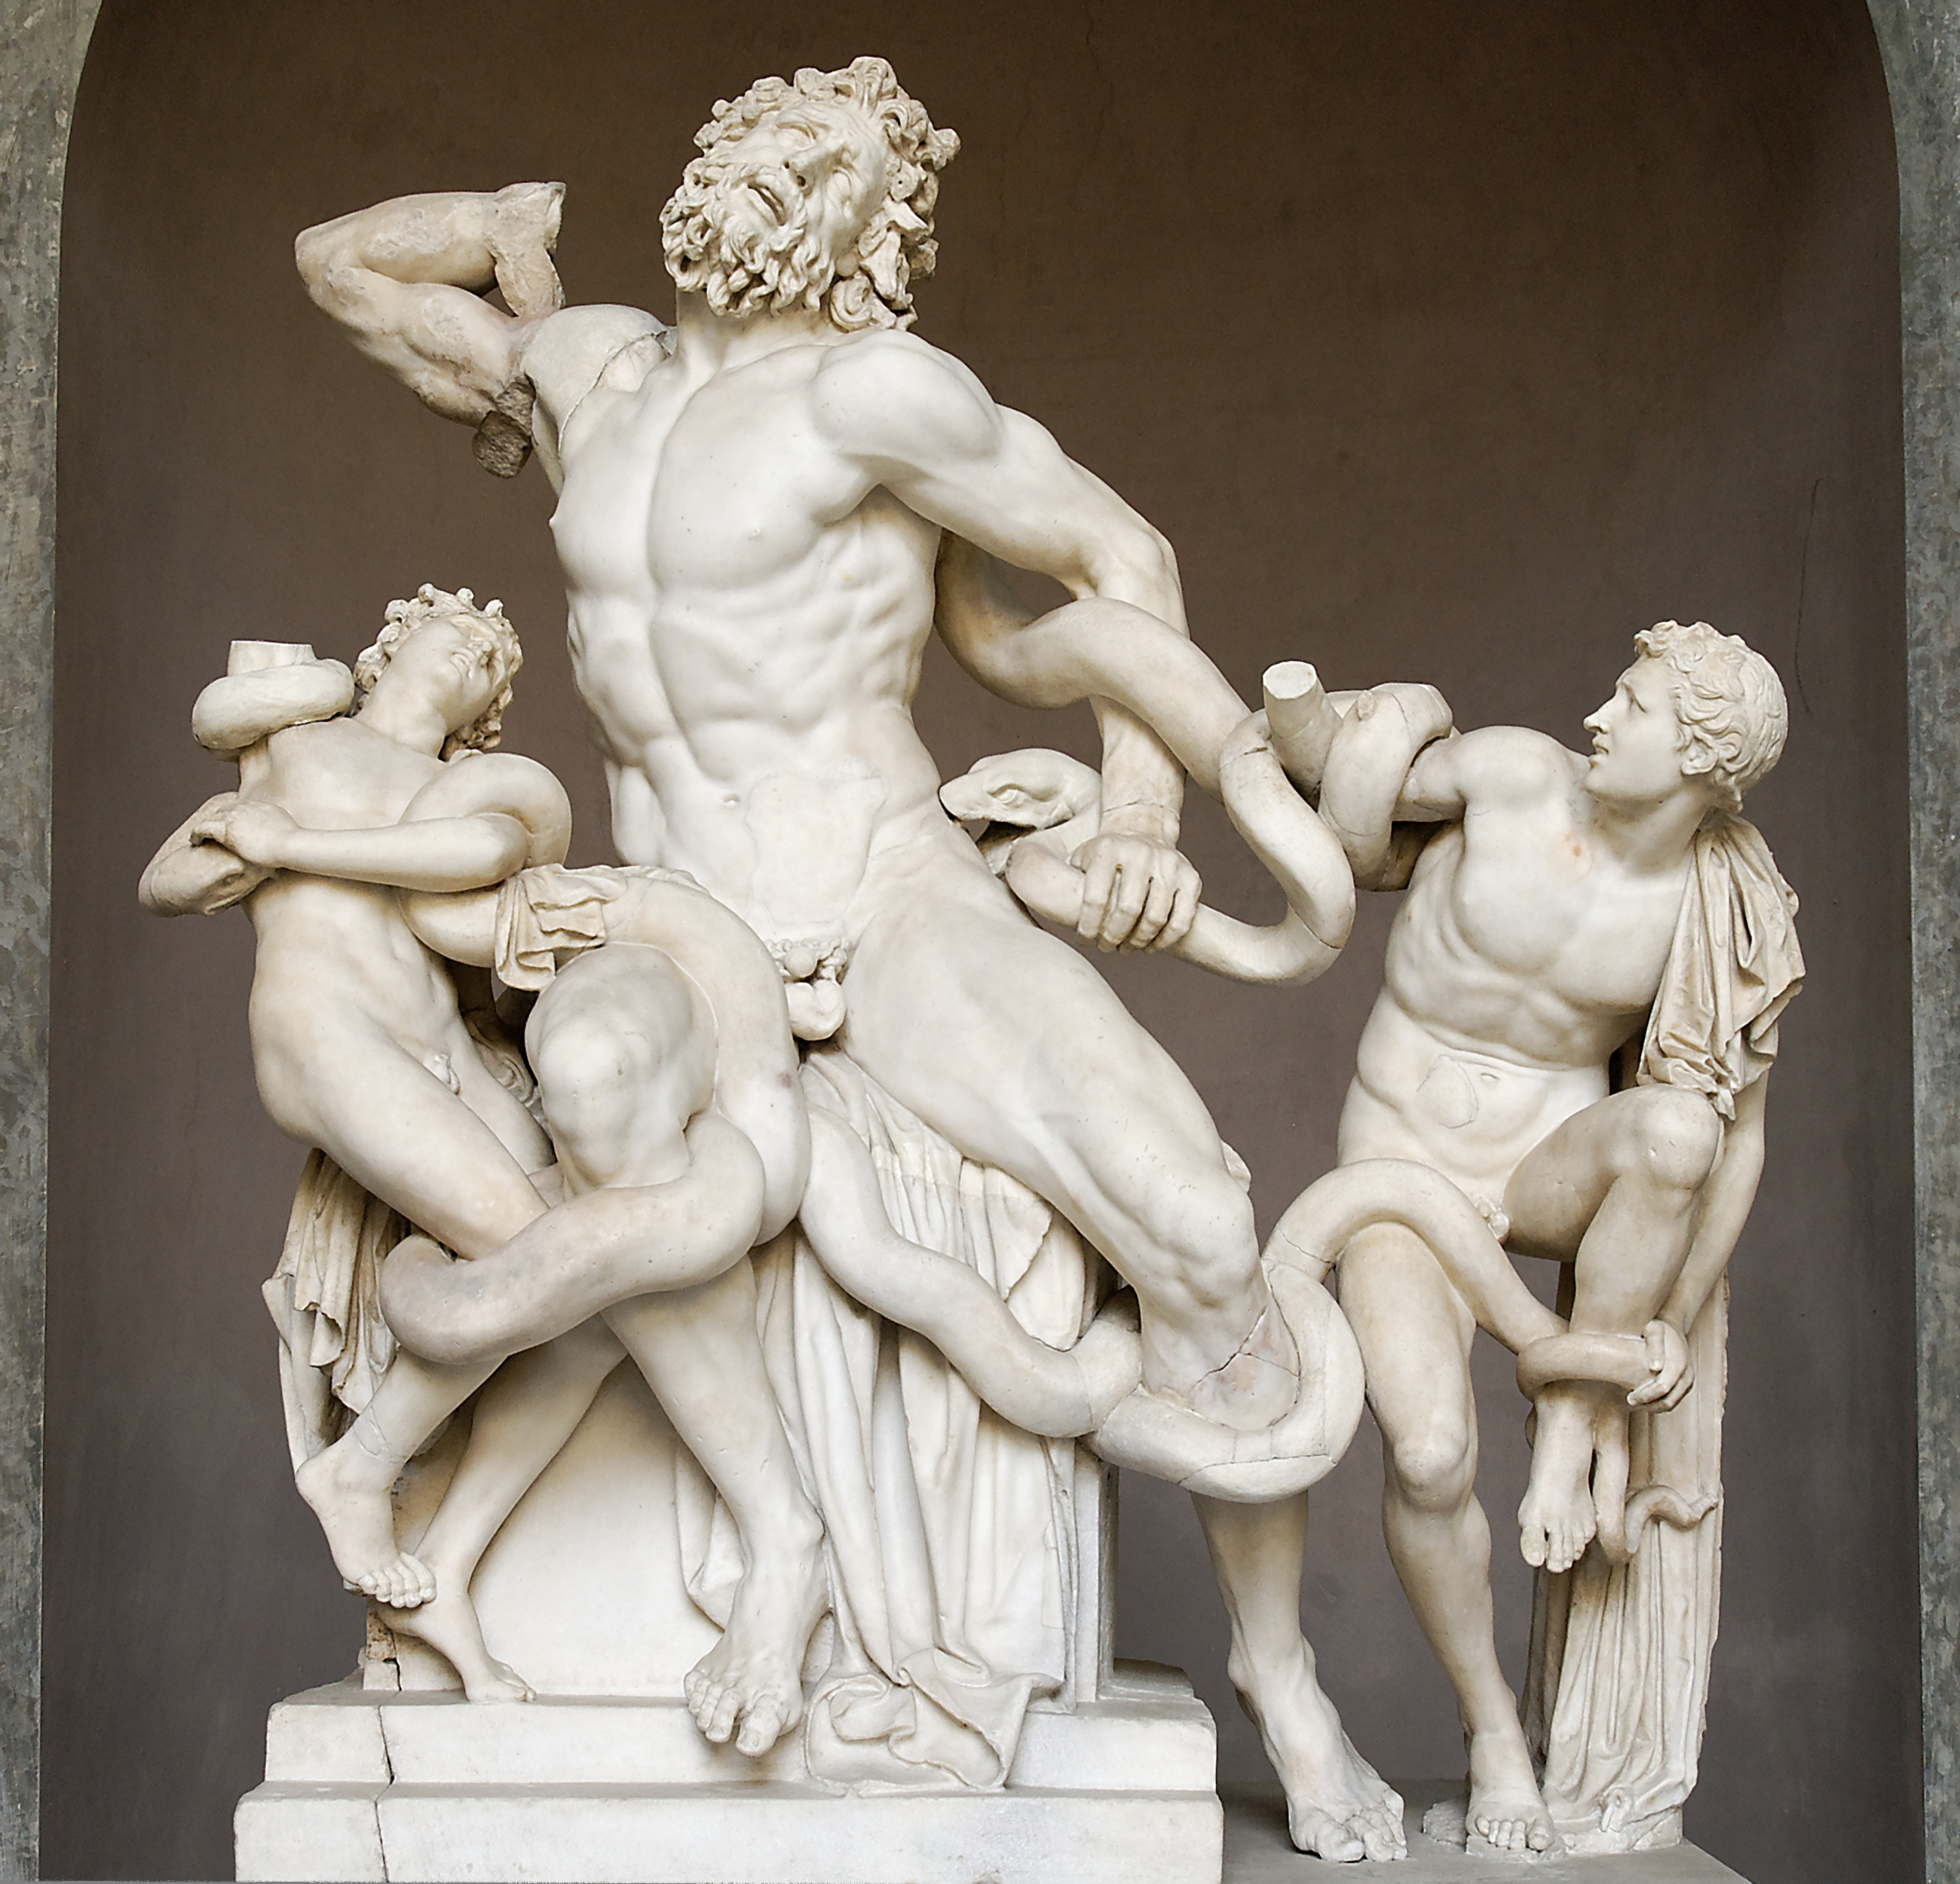
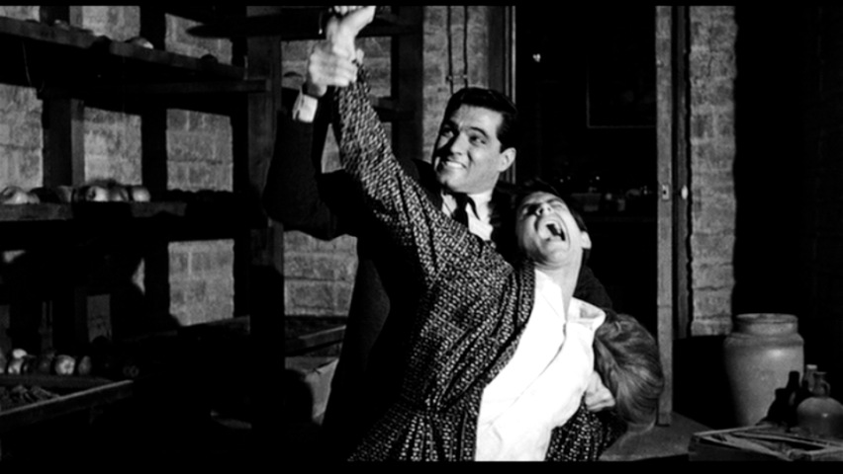
Fruitcellar Laocoon pose 00.35.16.21
Laocoon pose … or recollection of Van Mieris’ Susannah (or both?)?

Slide 25
GUS VAN SANT Parlour minus 1 00.35.16.21
there is a painting

Slide 26
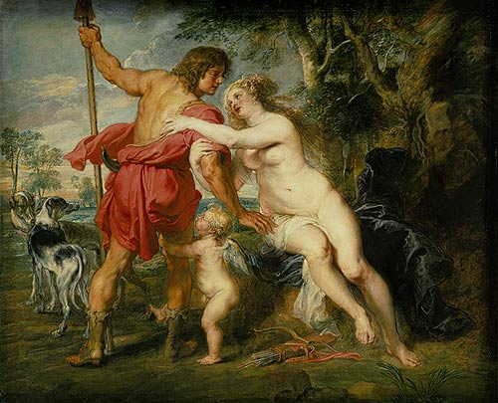
GUS VAN SANT Parlour 1 00.35.16.21
Peter Paul Rubens, "Venus and Adonis," mid- or late 1630s, Metropolitan Museum of Art, inv. 37.162, Gift of Harry Payne Bingham

Slide 27
GUS VAN SANT Parlour 3 00.35.16.21
nude female kneeling bather shown ¼ from rear

Slide 28
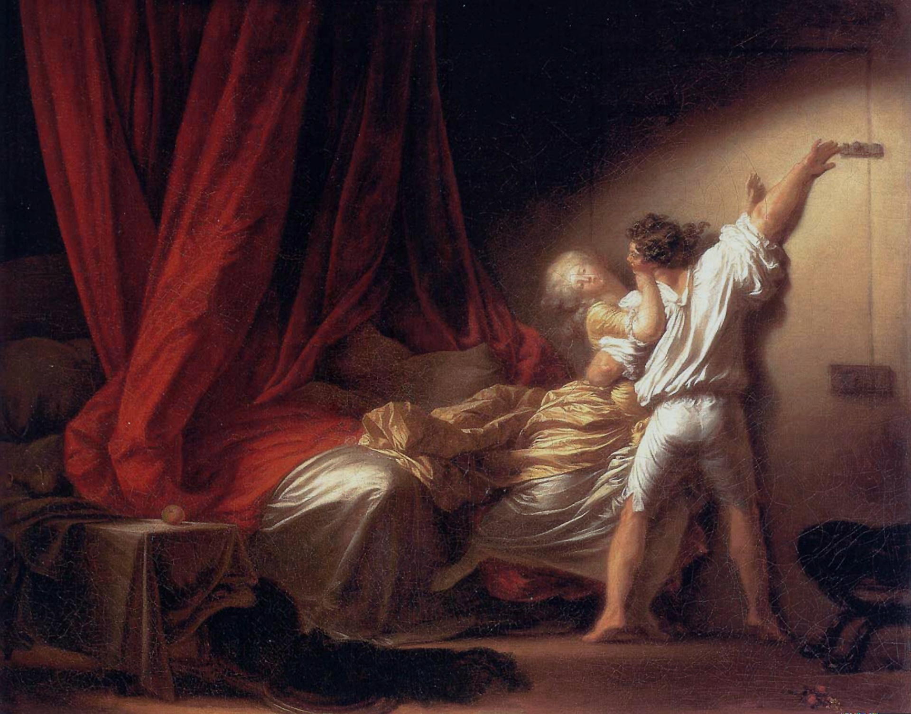
GUS VAN SANT Parlour 5 00.37.19
Jean-Honoré Fragonard, Le Verrou (The Bolt), ca. 1777, Musée du Louvre, R.F. 1974-2.
Van Sant crops it so that it is an upright rectangle, but he loses most of the erotic imagery at left.

Slide 29
GUS VAN SANT Parlour 6 00.35.16.21
Titian, Venus with a Mirror, c. 1555; National Gallery of Art, Andrew W. Mellon Collection 1937.1.34
Van Sant copies Hitchcock’s usage.

Slide 30
GUS VAN SANT Parlour 7 00.35.16.21
rectangular ascension of the blessed virgin in a blue dress
Van Sant positions Norman beneath this for his phonecall with Al Chambers.

Slide 31
GUS VAN SANT Parlour 8 00.35.16.21
never really appears in light

Slide 32
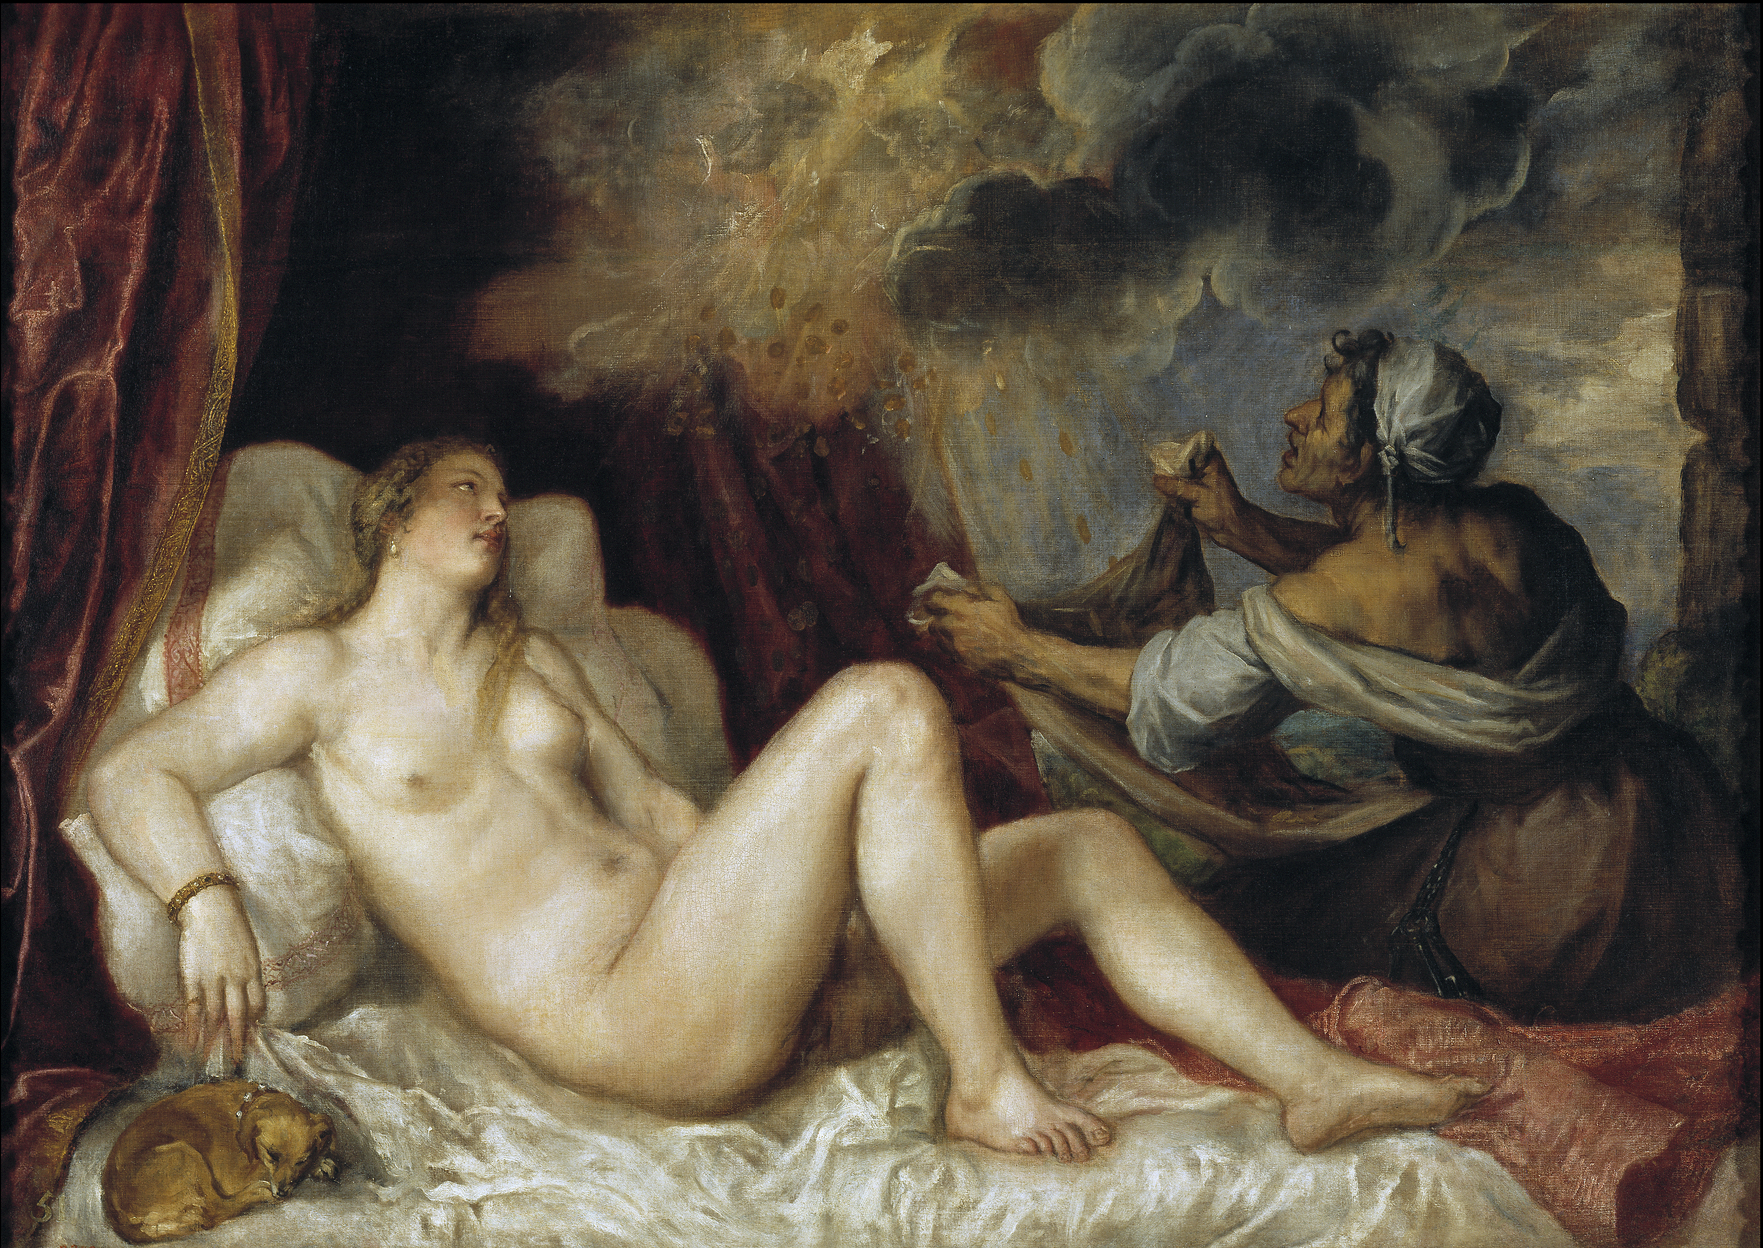
GUS VAN SANT Parlour 9 1.32.12
Titian, “Danaë Receiving the Golden Rain,” 1553-1554, Museo del Prado, Madrid.
(Three other versions exist. This seems clearly the one chosen in Van Sant set.)

Slide 33
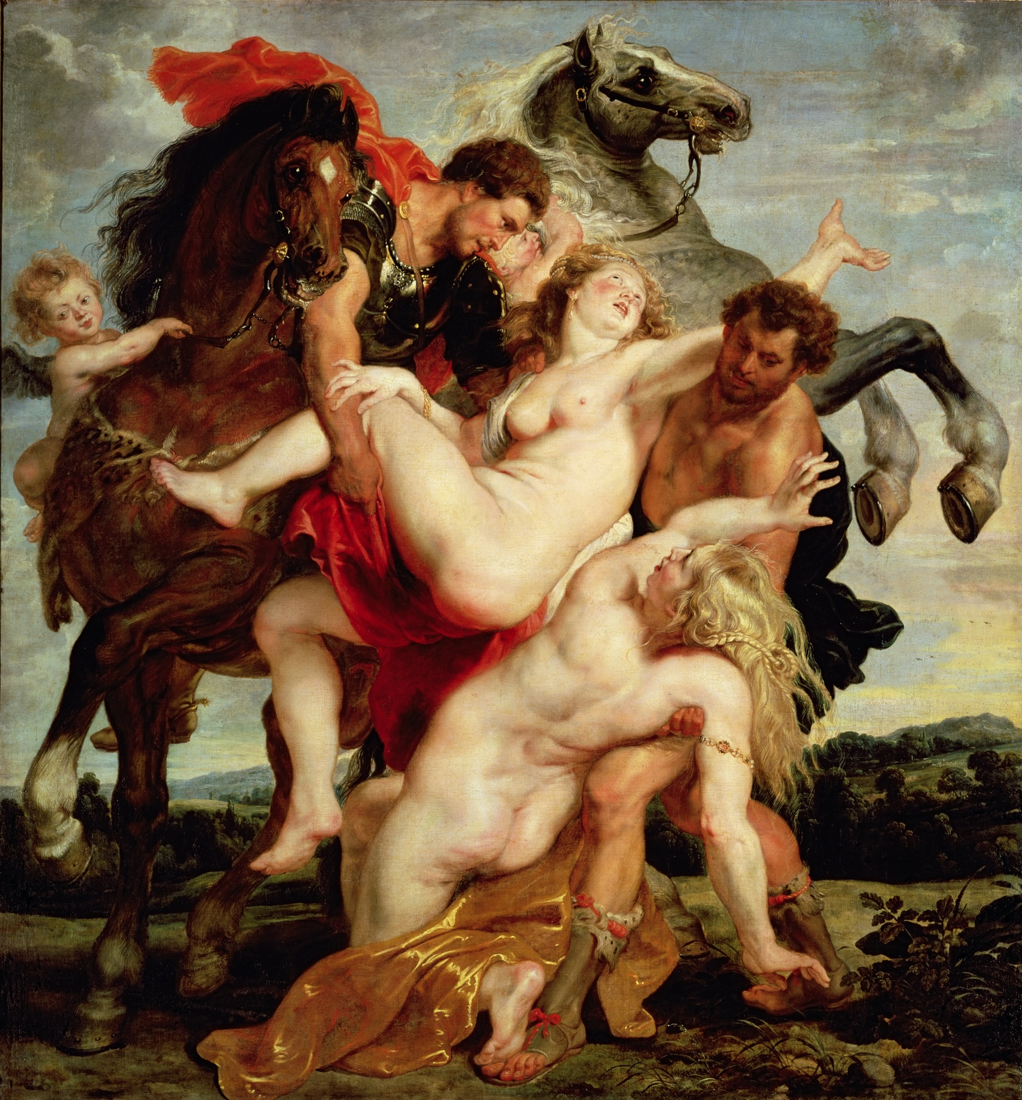
GUS VAN SANT Parlour 10 1.11.53
Peter Paul Rubens, “The Rape of the Daughters of Leucippus,” 1616-1618, Alte Pinakothek, Munich, inv. 321.
Van Sant overtly illuminates this painting as Arbogast enters the darkened parlour.

Slide 34
GUS VAN SANT Chambers House, NO mantle mini 00.35.16.21
a framed last supper appears in rear of Lila and Sam

Slide 35
GUS VAN SANT Bates Home, Eros statuette 00.35.16.21
“Houdon” is reused

Slide 36
GUS VAN SANT Bates staircase stilllife with flowers and grapes 1.21.02; 1.29.36
an oval still-life of flowers (to the left is another menagerie)
Later shot is better, because it shows Lila entering the bedroom and has more color. Petunias, roses, peaches, white grapes in an oval frame.

Slide 37
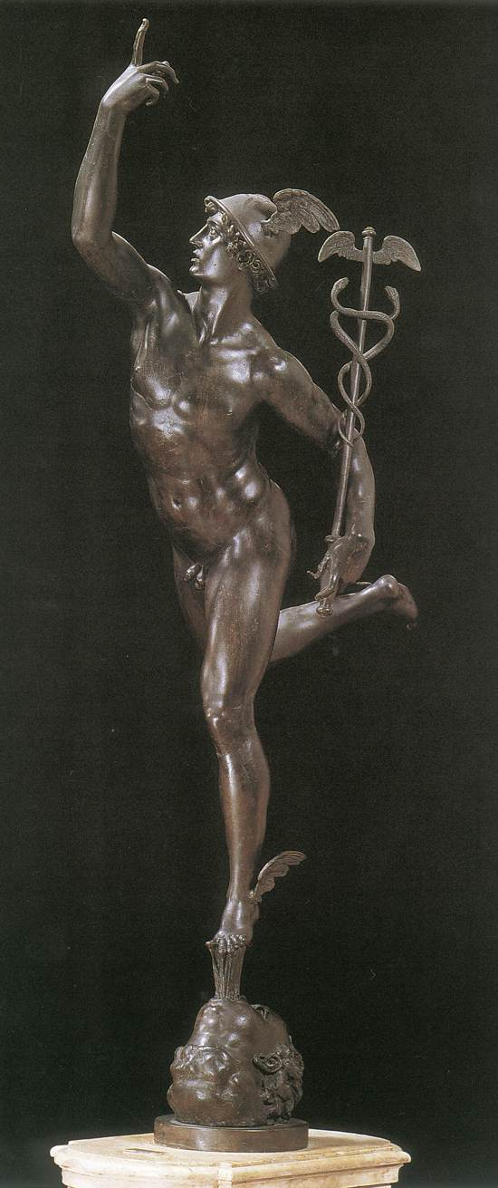
GUS VAN SANT Mrs Bates Bedroom 00.35.16.21
Copy of Giambologna’s Mercury substitutes for Verlet.
Van Sant’s use of Mercury (i.e. Hermes Psychopompos) could show some very sophisticated response to Hitchcock’s use of Orpheus.

Slide 38
GUS VAN SANT Fruitcellar 00.35.16.21
no Laocoon

