Slide 1
Heracles in Film

Slide 2
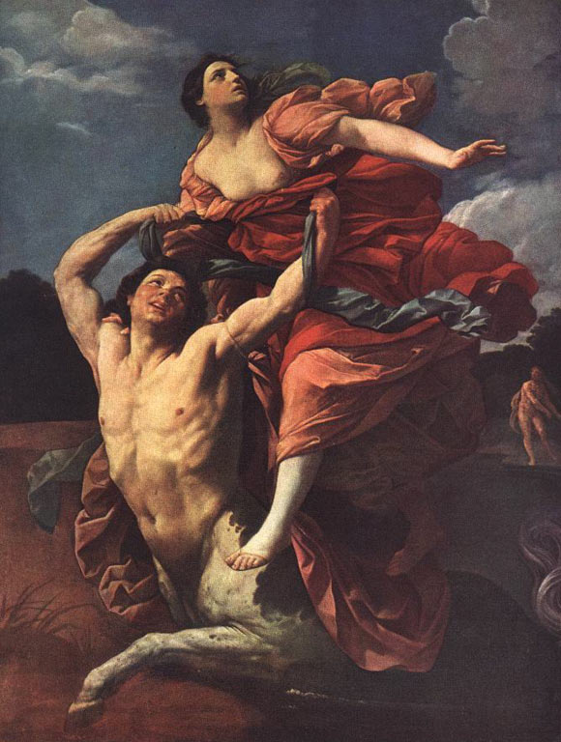
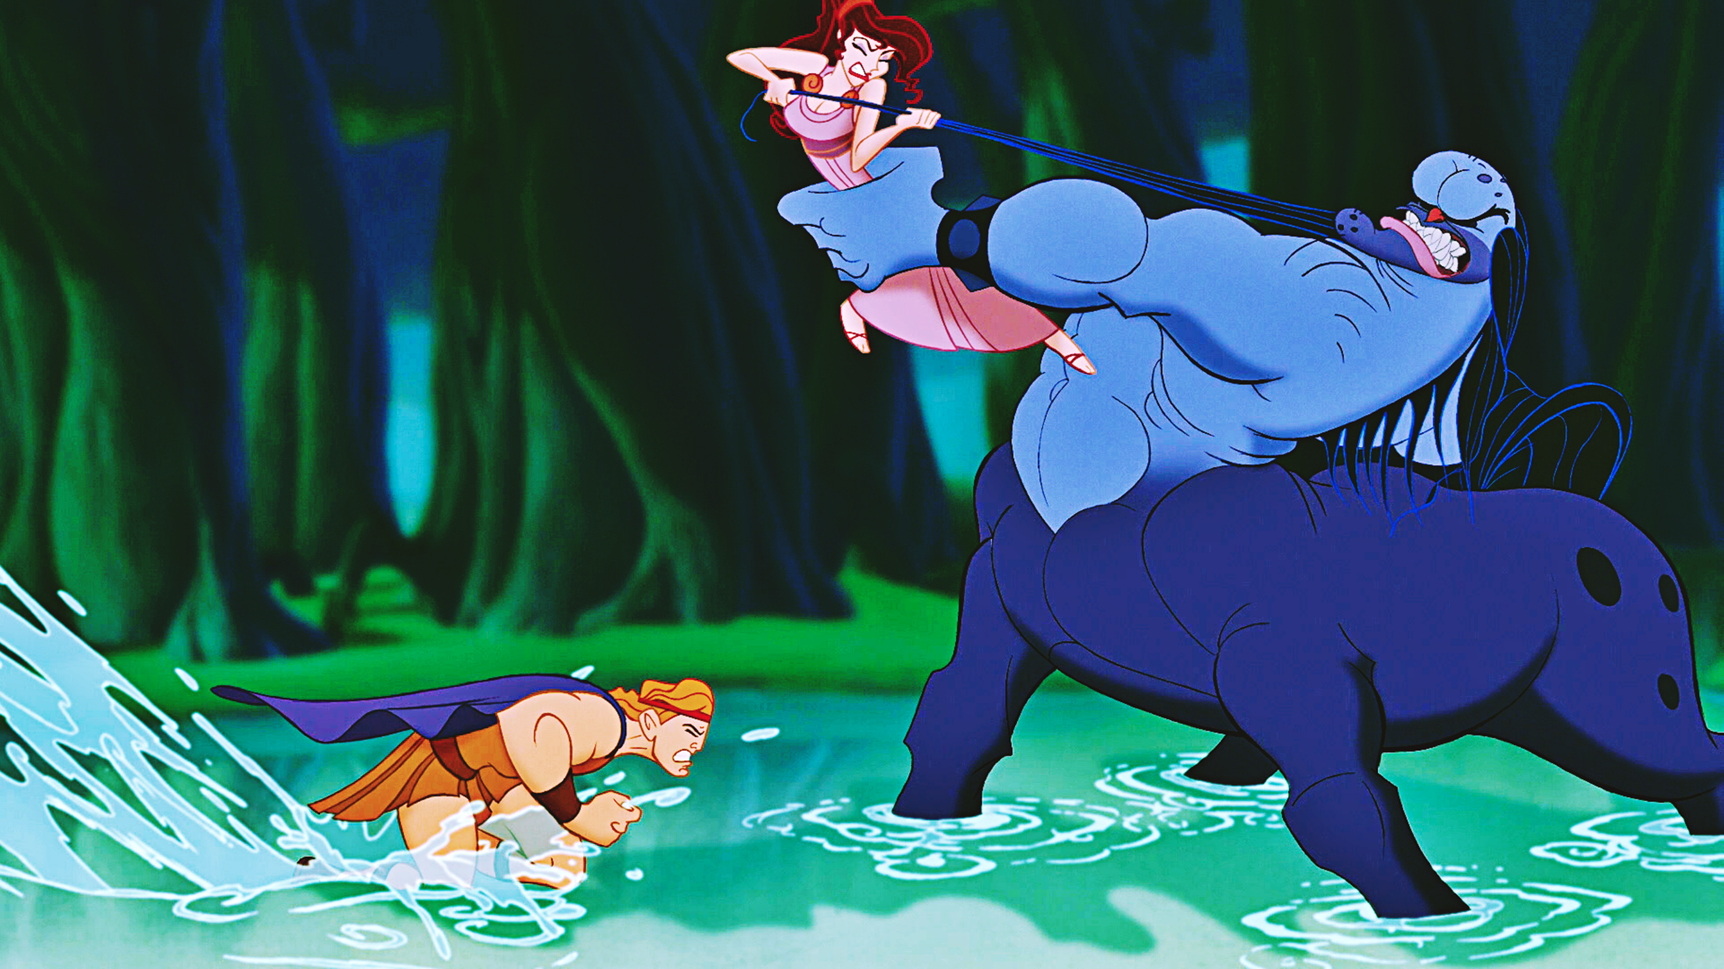
Guido Reni, Nessus’ Abduction of Deianira, 1620-21, Louvre
Clements & Musker Hercules 1997;
Herc rescues Meg from Nessus

Slide 3
OGCMA 535 “Heracles and Deianeira”
“After [the 12th labor and] winning the hand of Deianeira, Heracles brought her to Tiryns. On the way, they were assisted in crossing the flooded Evenus River by the centaur Nessus, who forded it with Deianeira on his back. When they reached the shore, the centaur tried to rape her, but Heracles killed him with a poisoned arrow. As he lay dying, Nessus told Deianeira to smear some of his blood on a garment, which would win back her husband’s love, if she should ever lose it. This was the ‘shirt of Nessus’ that later caused Heracles’ death.”
— cf. Soph. Trachiniae, Ovid Met. 8.542-9.133, Apollodorus Biblioteca 1.8.1-3, 2.7.5-7 and others.

Slide 4
See J. Solomon, The Ancient World in the Cinema, Rev. and exp. ed. (Yale UP, 2001), chapter 13 “Terpsichore”.
“The crowd cries for quick action, tons of raw beef and quivering muscles on which their lusting eyes can chomp.”

Slide 5
1957 Hercules (Le Fattiche di Ercole) dir. by P. Francisci, starring Steve Reeves
180-ish films in Franco- , Hispano- , Teutono- , American- , Egyptian- , or Yugo-Italian collaborations before 1964!
Calculation includes Goliath, Samson, Maciste, and Hercules films. Muscleman epics.
Cf. Ursus in Quo Vadis.

Slide 6
180-ish muscleman epics 1957 - 1964
Hercules Against the Sons of the Sun
Hercules in New York
Fire Monsters Against the Son of Hercules
Hercules and the Moon-Men (actually a Maciste film morphed by dubbing)
Hercules in the Haunted World
Hercules Unchained
Ulysses against the Son of Hercules

Slide 7
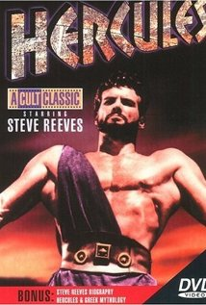
Steve Reeves, Montana native with awesome physique, is the undisputed leader of this ilk.
1940s Mr. World and Mr. Universe; 1957 Hercules, then several others until late 1960s.

Slide 8
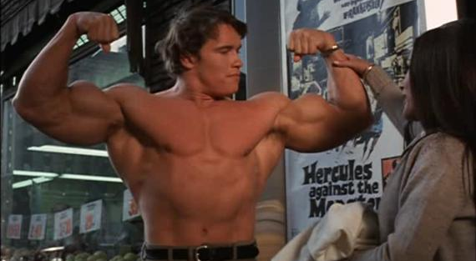
Arnold Schwarzenegger, Hercules in New York, 1970

Slide 9
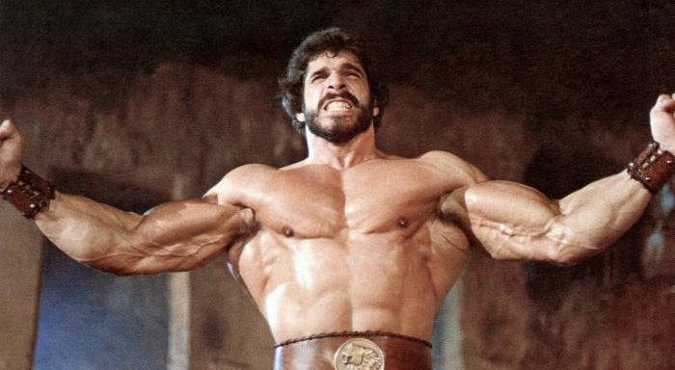
Lou Ferrigno, Hercules 1983

Slide 10
“One can find even Aristotelian catharsis in watching a man — be it the Lone Ranger, Steve Reeves, or the high-tech action hero of the nineties — who first suffers physical defeat but then uses his superby physical or mental skills to overcome evil and set all in its proper order.” p. 308

Slide 11
mens sana in corpore sano — Horace quoted by Solomon
“stones that no two mortals such as they are today could lift” — Homer
variants of titles “makes cataloguing these films frustrating today”
cf. 1961 Ercole alla Conquista di Atlantide (1961) = Hercules and the Conquest of Atlantis AND Hercules Conquers Atlantis AND Hercules and the Captive Women AND Hercules and the Haunted Women.

Slide 12
“All the musclemen of antiquity were summoned to carry [the] scores of barechested plots in the early 1960s, and it mattered little whom the film was about.”

Slide 13
The Italian fascination gave way to the rise of the Spaghetti Western, with Sergio Leone’s 1964 A Fistful of Dollars, the film which single-handedly invented the genre.
1990s TV programming featured very popular Hercules: the legendary journeys (Kevin Sboro)
300’s star Gerard Butler may have only 18-inch biceps, but the sword-and-sandal epic began again in 2006 (or so….)

Slide 14
Classical Heracles goes it alone... all the way. Indeed, because Eurystheus determines that two Labors were performed with assistance, the terms of the heroic expiation are upped from 10 tasks to 12. Ratner's Hercules functions by different rules altogether, and his 2014 myth is considerably different.
How do you think Ratner's heroic narrative is improved/hampered by this change in the heroic enterprise?

