Slide 1
Cacoyannis’ Iphigenia (1977)
A Cinematic adaptation of Euripides’ Iphigenia at Aulis
Roger T. Macfarlane Classical Studies, Comparative Arts & Letters For International Cinema
ogcma.byu.edu/Iphigenia2.0010_Cacoyannis.htm

Slide 2
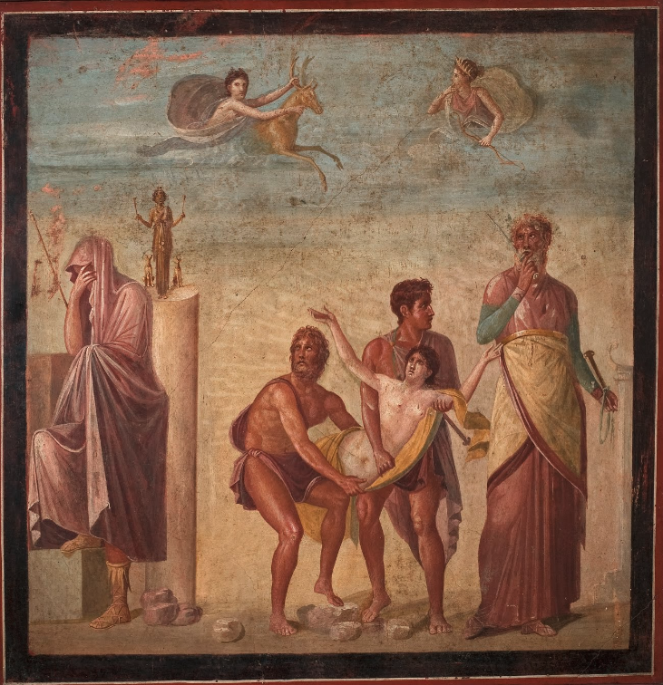
The Sacrifice of Iphigenia, fragment of fresco, 25-79 AD; Pompeii, House of the Tragic Poet; MAN inv. 9112
Two narrative planes:
below — Iphigenia carried from Agamemnon (l.) to Calchas (r.) by Ulysses and Diomedes; column w/ Diana (or Hecate)
above — Iphigenia transported by proxy-sacrificial hind to Diana’s presence
image from Google Arts & Culture

Slide 3

Tantalus => Pelops => Pleisthenes
Thyestes = Daeto Atreus = Aerope
= Pelopeia sons
Aegisthus Agamemnon = Clytemnestra Menelaus = Helen
Iphigenia Electra a daughter Orestes Hermione
The House of Atreus, after Euripides
ogcma.byu.edu

Slide 4
Iphigenia, played by Tatiana Papamoschou
Papamoschou (b. 1964, Athens) was an amateur actor when the film was made
Key scenes: throughout… but especially the two speeches to her parents — a) better to live in shame than to die in glory, then b) her urging Clytemnestra against retaliation and Achilles against foolish heroics.

Slide 5
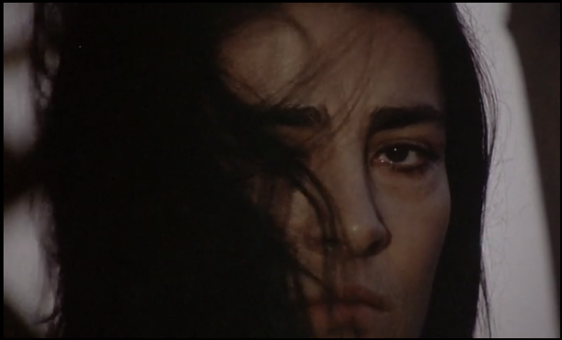
Clytemnestra, played by Irene Papas
Papas is one of Greek cinema’s most accomplished actors, the star of Cacoyannis’ Electra and featured as Helen in his Trojan Women
Watch in this film how she transforms from a loving, careful mother who cannot think of missing her daughter’s wedding into a bitter woman with abundant reason to consider revenge.
Key scenes: the eager inquiry about Achilles’ past, the final POV shot (with Papas’ glorious Hellenic hair menacing across the camera lens)

Slide 6
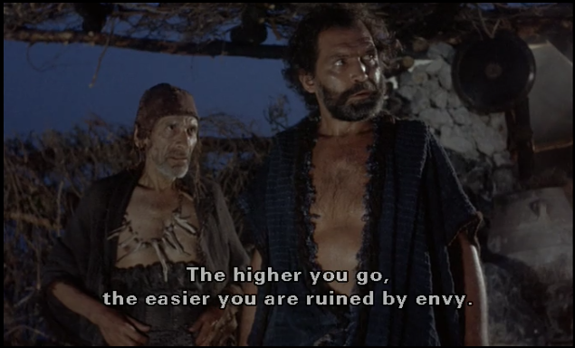
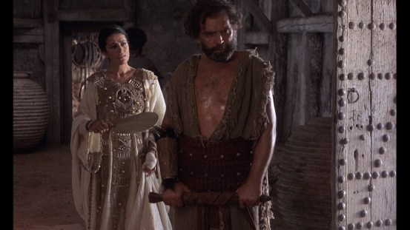
Agamemnon, played by Kostas Kazakos
For Agamemnon, life at the top is lonely.
Key scenes: throughout; interactions with Menelaus, Calchas, Odysseus, Iphigenia, Clytemnestra, the old slave…

Slide 7
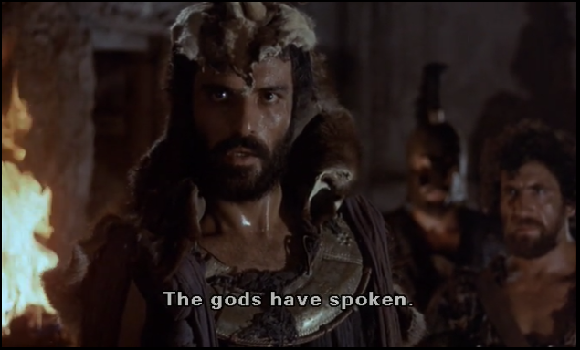
Calchas, played by Dimitris Aronis
Calchas is silent in the moment when the sacred stag is killed in Artemis’ sanctuary. Later he conveys the goddess’s proclamations.
Charlatan or prophet? Homer, too, crafts for Agamemnon a fraught relationship with Calchas in Iliad 1.
What is the relationship with Odysseus?

Slide 8
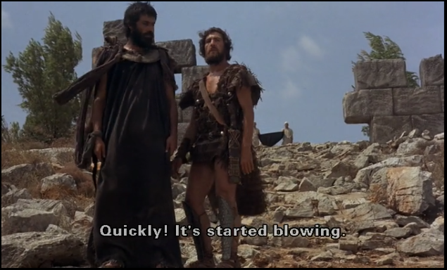
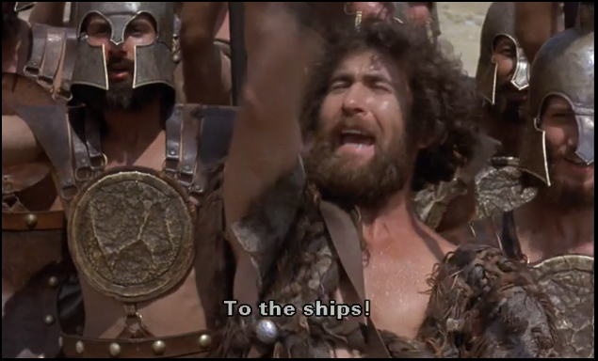
Odysseus, played by Christos Tsagkas
Euripides has Agamemnon call him Odysseus the Son of Sisyphus (i.e. the arch-schemer). Clytemnestra, too.
Odysseus’ exultant call to the men to board the ships discords with the extreme attempts the Ithacan made to avoid inclusion in the expedition.
Within the film Iphigenia, Odysseus is busily leading the plot. But, WHO — Odysseus or Calchas — actually in charge? (Agamemnon’s not!)

Slide 9
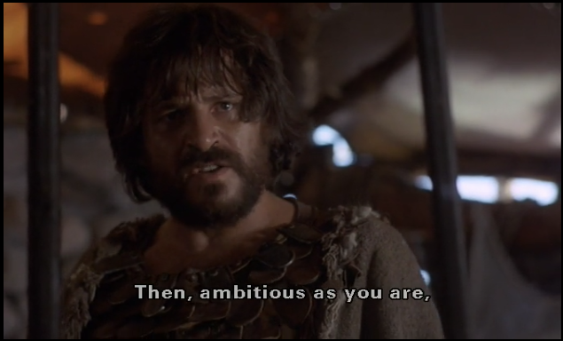
Menelaus, played by Kostas Karras
Menelaus is classical literature’s greatest cuckhold, the husband of Helen; but he is also the king of Sparta and the brother of Agamemnon.
In this narrative, as in Euripides’ play, Menelaus migrates from Agamemnon’s intensely honest critic to being the king’s only friend.

Slide 10
Achilles, played by Panos Michalopoulos
Key scenes: Achilles lies naked [annotated by RTM] on the beach enjoying the moment; his promise to fight the thousands of Greeks comes to nothing

Slide 11
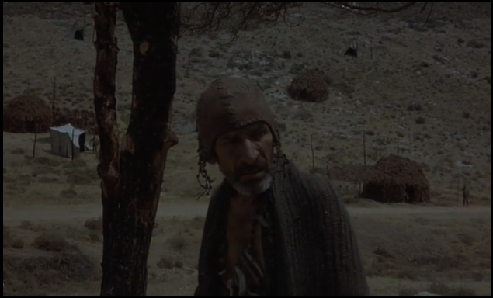
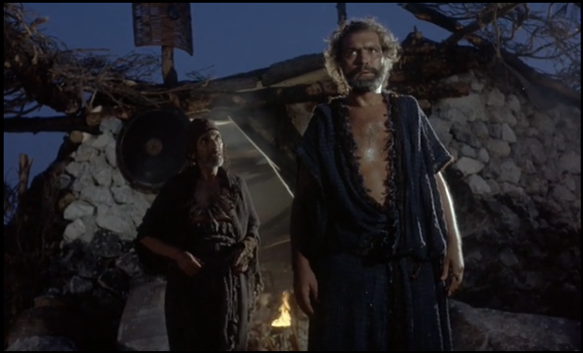
The Old Man, played by Angelos Giannoules
This character plays an important part in Euripides’ play. In Cacoyannis’ adaptation he is ever-present but given many fewer lines.
Key scene: his involvement in disclosing the truth of Iphigenia’s wedding plans to Achilles and Clytemnestra.
Presbyteros in Euripides, Hyperetes in Cacoyannis

Slide 12
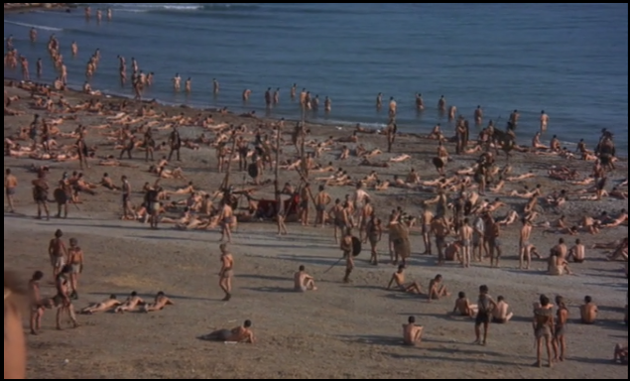
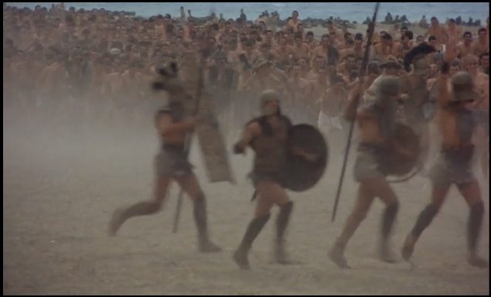
The Malleable Army, played by a host of Idle extras
The troops marshalled by the many kings of Hellas under Agamemnon’s general command are listless and prone to mutiny during the majority of the film. The sacrifice of Iphigenia energizes them so immediately that they don’t even wait for her to blood to flow before they rush to the ships.
This is a thronging “character” that Euripides cannot provide on stage.

Slide 13
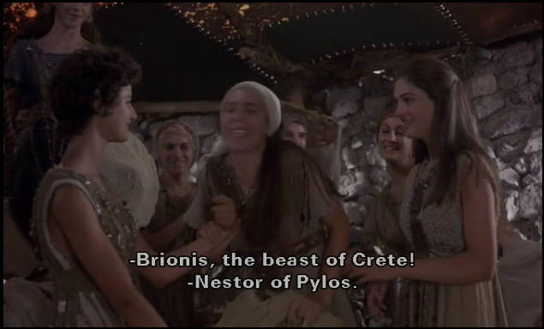
The Chorus of ARgive maidens, a group of Iphigenia’s “peers”, star-struck teeny-boppers
The first choral ode in Euripides’ play is a catalog of ships (cf. Hom. Il. 2). The girls who attend to Iphigenia in Cacoyannis’ film deliver this information at 1:08:41.
Euripides’ second choral ode, a hymn to Aphrodite begging her to keep Eros’ harsh effects (i.e. erotic passion) at a distance, is transposed by Cacoyannis into Clytemnestra’s motherly training. The chorus girls listen.
The chorus is a conventional feature that Euripides must provide on stage. In IA, Euripides’ chorus is comprised of local, Colchian star-struck women. Cacoyannis repurposes the chorus to provide Iphigenia with a social group, girls who can be girls when Iphigenia cannot.

Slide 14
An Historisist’s Moment: Cacoyannis and Greece in 1977 Euripides and Athens in 407 BC
The third of Cacoyannis’ “Euripidean Trilogy:
Electra / ΗΛΕΚΤΡΑ (1962)
Trojan Women (1971)
Iphigenia / ΙΦΙΓΕΝΕΙΑ (1977)
Euripides’ posthumous thinker:
playwright died 407 BC
Iphigenia at Aulis / ΙΦΙΓΕΝΕΙΑ Η ΕΝ ΑΥΛΙΔΙ produced posthumously at Athens 405 BC the text is fraught
cf. Iphigenia among the Taurians (ca. 413 BC)
Is there no culpability for horrendously bad leadership?
Cacoyannis’ thinker:
Fall of the Junta, or “Reign of the Colonels”, in July 1974 following the failed Coup in Cyprus
Is there no culpability for horrendously bad leadership?

Slide 15
Cacoyannis’ filmcraft
“authenic” sets
adapted archaeologically at Mycenae
but not so much at “Aulis” — a composite of Loutraki (beach near Corinth) and Chaidari (military base near Athens
primitivist costuming and properties “Deceptively genuine…: ‘One of the buildings has Roman-style arches, but only archaeologists will be offended.’” Huyssen (2006)
First 35 minutes integrate original prologue material with narrative
Adjustments of chorus and choral odes
Inclusion of the army, the fickle throng
Spaghetti-westernesque blocking, especially in the vendetta between Agamemnon and Calchas/Odysseus

Slide 16
Aristotle Poetics 15.1454a
Of the four character traits to strive for, the fourth should be consistency of character. … An illustration of inconsistency is Iphigenia at Aulis (for the girl who begs for her life bears no resemblance to the later girl). — 1211ff. vs 1368ff.
— trans. after S. Halliwell
Περὶ δὲ τὰ ἤθη τέτταρά ἐστιν ὧν δεῖ στοχάζεσθαι … τέταρτον δὲ τὸ ὁμαλόν. … ἔστιν δὲ παράδειγμα … τοῦ ἀνωμάλου ἡ ἐν Αὐλιδι Ἰφιγένεια· οὐδὲν γὰρ ἔοικεν ἡ ἱκετεύουσα τῇ ὑστέρᾳ.

Slide 17
Euripides IA 1211ff. a step toward dramatic novelty
… So, I summarize it in one sentence and win this argument thus: to gaze upon the light is the sweetest thing for mortals; the netherworld is nothing; the person who prays to die is crazy; living in bad circumstances is better than dying nobly. — trans. Macfarlane
“It’s better to be unhappy and alive than to be dead and glorified.” — Iphigenia in Cacoyannis
ἕν συντεμοῦσα πάντα νικήσω λόγον. τὸ φώς τοδ᾿ ἀνθρώποισιν ἥδιστον βλέπειν, τὰ νέρθε δ᾿ οὐδεν· μαίνεται δ᾿ὃς εὔχεται θανεῖν· κακῶς ζῆν κρεῖσσον ἢ καλῶς θανεῖν. — 1249-52

Slide 18
Euripides IA 1368ff. — Achieving Dramatic Novelty A little girl pursuing Kleos, as Savior of Greece
Εἰς ἔμ᾿ Ἑλλὰς ἡ μεγίστη πάσα νῦν ἀποβλέπει, κἀν ἐμοὶ πορθμός τε ναῶν καὶ Φρυγῶν κατασκαφαὶ τάς τε μελλούσας γυναῖκας, ἤν τι δρῶσι βάρβαροι, μηκέθ᾿ ἁρπάζειν ἐᾶν τὰς ὀλβίας ἐξ Ἑλλάδος, τὸν Ἑλένης τείσαντας ὄλεθρον, ἣν ἀνήρπασεν Πάρις. Ταύτα πάντα κατθανοῦσα ῥύσομαι, καί μου κλέος, Ἑλλάδ᾿ ὡς ἠλευθέρωσα, μακάριον γενήσεται. — 1377-1385
All of great Hellas looks now to me. Indeed, Through me comes the ships’ passage and Troy’s sack. Never again will barbarians assault and take captive Women from their happiness in Hellas; nor will women Pay the shame of Helen whom Paris abducted. Every one of these things shall I set aright in my death. This shall be my fame — how I set Hellas free. My fame shall be blessed.
— trans RTM

Slide 19
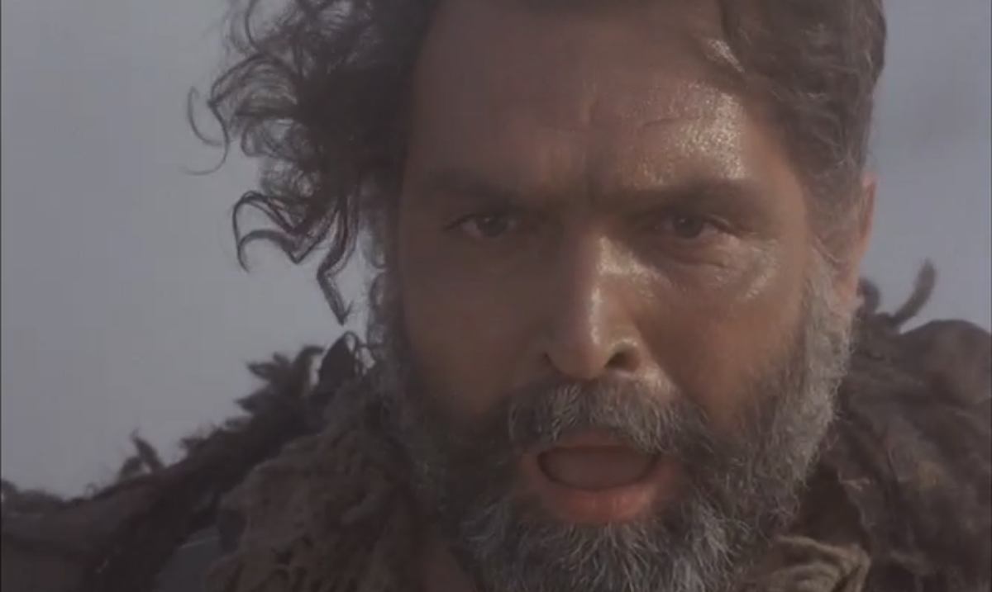

Slide 20
What does Agamemnon see through the mist? And… How in the world could he not stop this from happening?

