Slide 1
The Orpheus Theme in Swarup’s Q&A and Boyle’s Slumdog Millionaire
Roger T. Macfarlane
Brigham Young University
CAMWS 2014, 5G Onscreen Receptions I

Slide 2
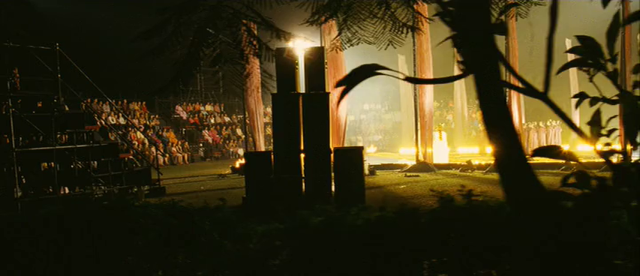
CAMWS 2014, 5G Onscreen Receptions I

Slide 3

deleted scene: Jamal learns about Orpheus
http://youtu.be/liOKBj5q7T0
CAMWS 2014, 5G Onscreen Receptions I

Slide 4
The Questions: west vs. east
10 questions to 10m Rs.
12 (or 13) questions to 1b Rs.
Indian Cinema — Bollywood
Indian nationalism
Hinduism — Krishna
British Colonialism — architecture
Indian popular music
American capitalism
American violence — S. Colt
cricket — British Colonialism
British Colonialism
European Literature (Dumas)
Indian Cinema — Bollywood
Christianity
celestial astronomy
Indian popular music
International diplomacy
World geography
American violence — S. Colt
Indian military
cricket — Indian prowess
Indian cinema— Mumtaz Mahal
European Literature (Shakespeare)
Mughal history — Mumtaz Mahal
Western classical music
1
CAMWS 2014, 5G Onscreen Receptions I

Slide 5
The Questions: west vs. east
10 questions to 10m Rs.
12 (or 13) questions to 1b Rs.
Indian Cinema — Bollywood
Indian nationalism
Hinduism — Krishna
British Colonialism — architecture
Indian popular music
American capitalism
American violence — S. Colt
cricket — British Colonialism
British Colonialism
European Literature (Dumas)
Indian Cinema — Bollywood
Christianity
celestial astronomy
Indian popular music
International diplomacy
World geography
American violence — S. Colt
Indian military
cricket — Indian prowess
Indian cinema— Mumtaz Mahal
European Literature (Shakespeare)
Mughal history — Mumtaz Mahal
Western classical music
2
CAMWS 2014, 5G Onscreen Receptions I

Slide 6
The Questions: west vs. east
10 questions to 10m Rs.
12 (or 13) questions to 1b Rs.
Indian Cinema — Bollywood
Indian nationalism
Hinduism — Krishna
British Colonialism — architecture
Indian popular music
American capitalism
American violence — S. Colt
cricket — British Colonialism
British Colonialism
European Literature (Dumas)
Indian Cinema — Bollywood
Christianity
celestial astronomy
Indian popular music
International diplomacy
World geography
American violence — S. Colt
Indian military
cricket — Indian prowess
Indian cinema— Mumtaz Mahal
European Literature (Shakespeare)
Mughal history — Mumtaz Mahal
Western classical music
3
CAMWS 2014, 5G Onscreen Receptions I

Slide 7
The Questions: west vs. east
10 questions to 10m Rs.
12 (or 13) questions to 1b Rs.
Indian Cinema — Bollywood
Indian nationalism
Hinduism — Krishna
British Colonialism — architecture
Indian popular music
American capitalism
American violence — S. Colt
cricket — British Colonialism
British Colonialism
European Literature (Dumas)
Indian Cinema — Bollywood
Christianity
celestial astronomy
Indian popular music
International diplomacy
World geography
American violence — S. Colt
Indian military
cricket — Indian prowess
Indian cinema— Mumtaz Mahal
European Literature (Shakespeare)
Mughal history — Mumtaz Mahal
Western classical music
4
CAMWS 2014, 5G Onscreen Receptions I

Slide 8
The Questions: west vs. east
10 questions to 10m Rs.
12 (or 13) questions to 1b Rs.
Indian Cinema — Bollywood
Indian nationalism
Hinduism — Krishna
British Colonialism — architecture
Indian popular music
American capitalism
American violence — S. Colt
cricket — British Colonialism
British Colonialism
European Literature (Dumas)
Indian Cinema — Bollywood
Christianity
celestial astronomy
Indian popular music
International diplomacy
World geography
American violence — S. Colt
Indian military
cricket — Indian prowess
Indian cinema— Mumtaz Mahal
European Literature (Shakespeare)
Mughal history — Mumtaz Mahal
Western classical music
5
CAMWS 2014, 5G Onscreen Receptions I

Slide 9
narrative direction
Slumdog Millionaire
Q&A
multivalent narrative
three sets of actors mature
each brother learns and manifests understanding of Love
linear
protagonist matures
enhanced engagement with the eternal feminine and ennobling Love

