Slide 1
Clements & Musker’s Nessus
a quick comparison to classical mythographers

Slide 2
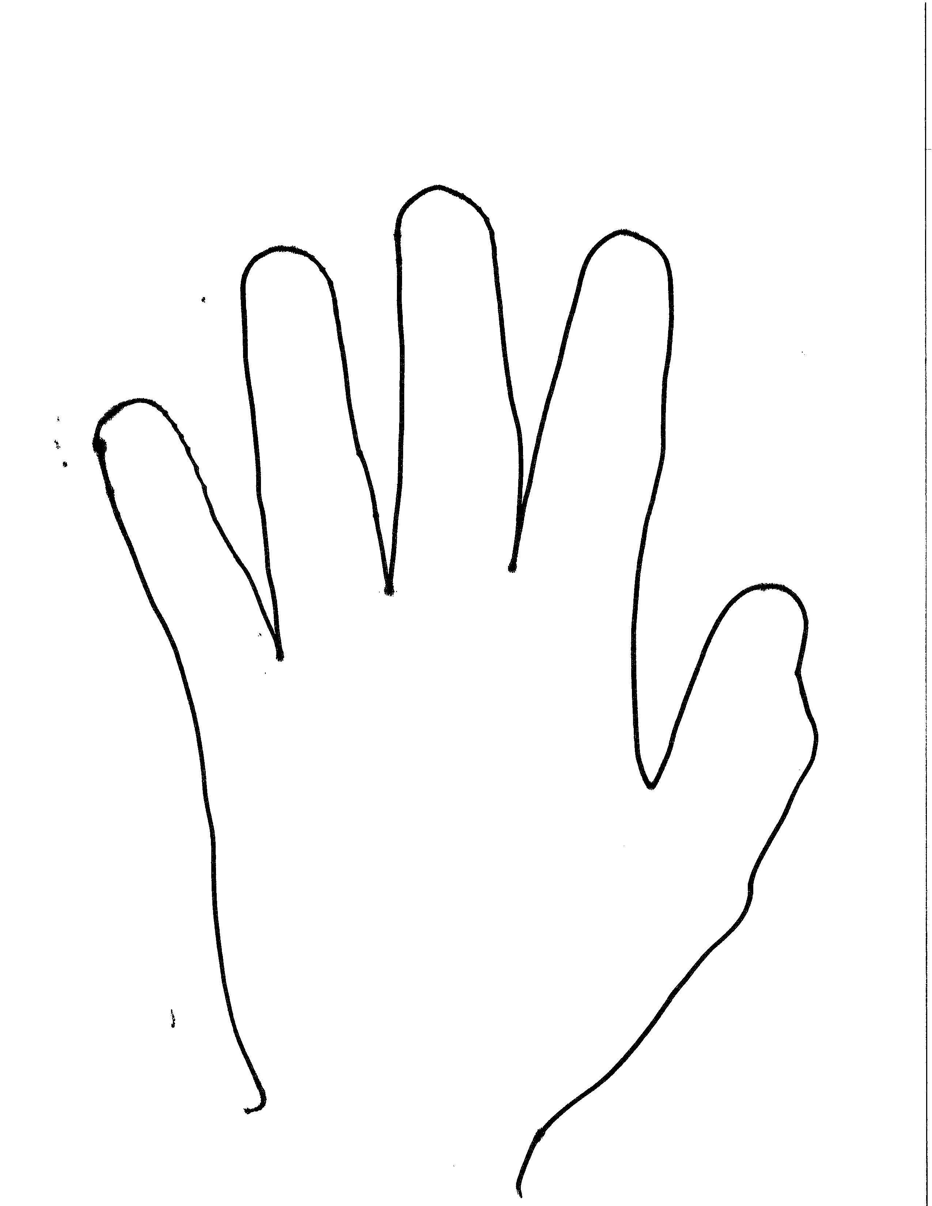
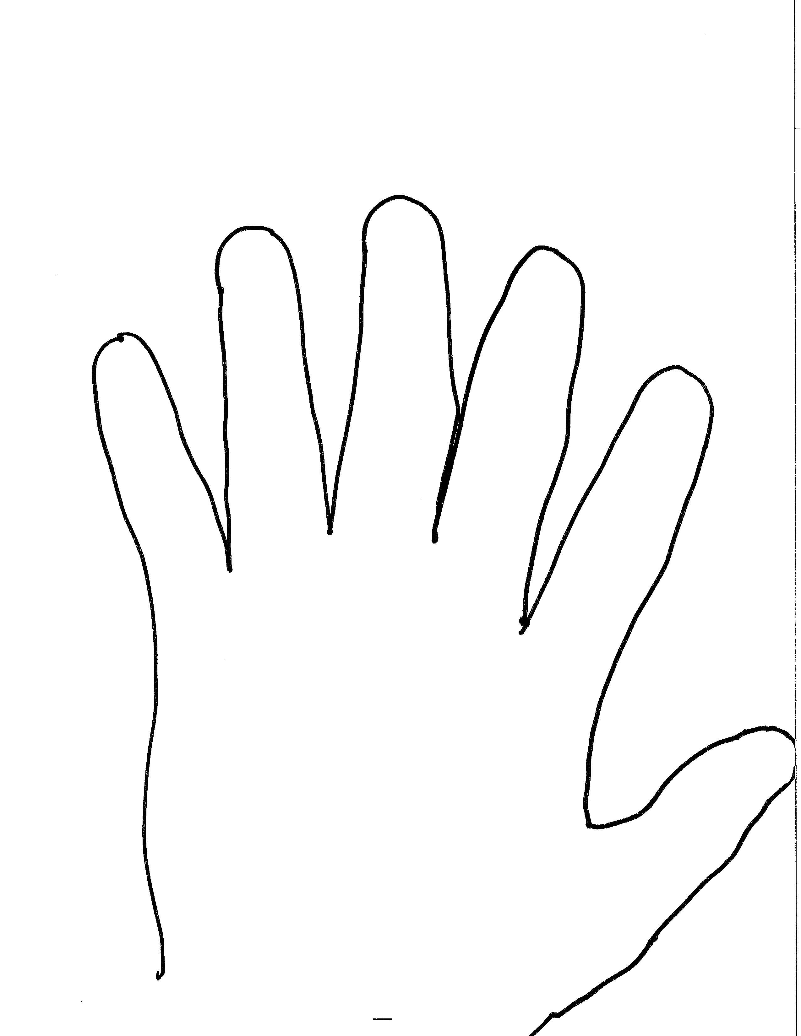
Clements & Musker’s Nessus vs. Classical authors’
Sequencing in C&M
Classical sequencing
Herc encounters Nessus early
Meg is involved with Nessus before Herc & Phil arrive
Herc meets Meg as result of his successful bashing of Nessus
Megara is bride of Heracles’ youth, and he expiates her murder by the 12 Labors
Deianeira, the bride of his post-labor life, is compromised by Nessus… the beginning of the hero’s end — thus late in career
After Nessus encounter, Deianeira and Heracles live a long life and have many kids together
The encounter with Nessus is indirect and results in the centaur’s death
Principle: the handturkey gets more interesting when we note
variations from expectations.

