Slide 1
La Chimera (2023, Rohrwacher)
some points for discussion after watching
Roger T. Macfarlane Professor of Classical Studies

Slide 2
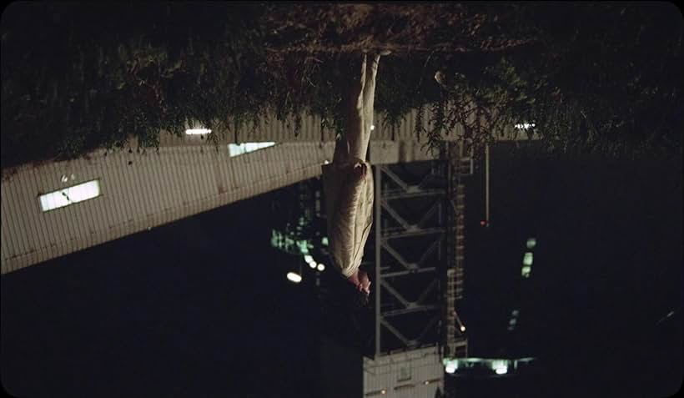
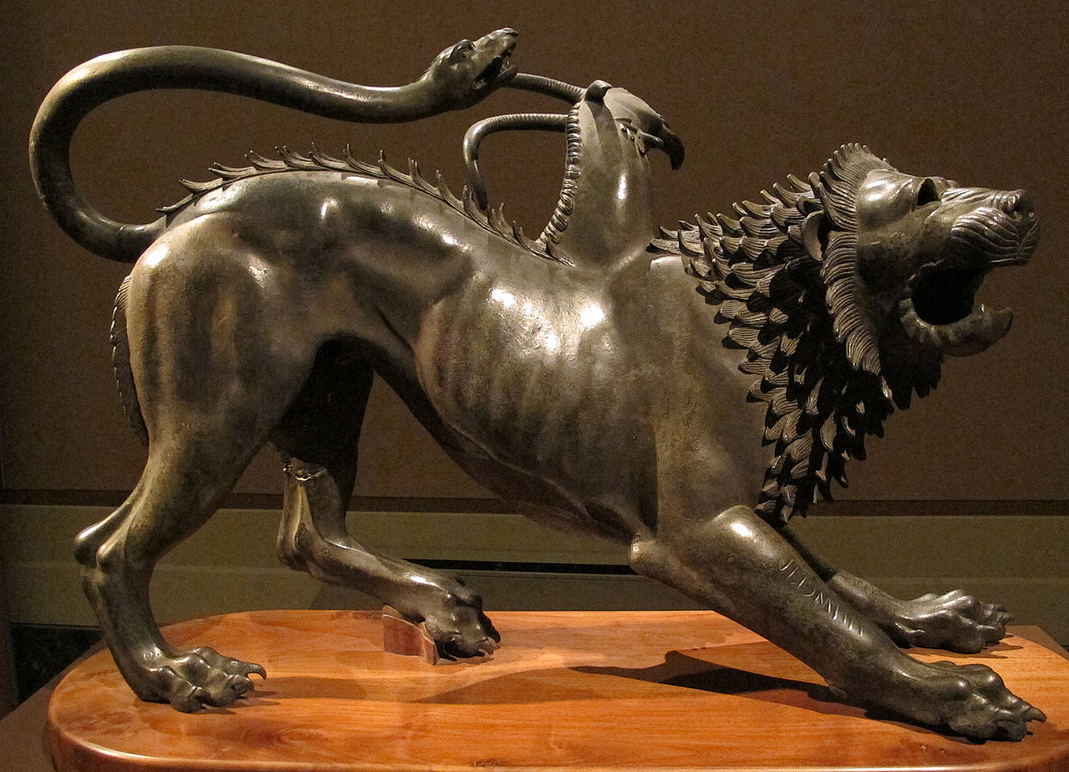
chimera = pipe-dream inseguire delle chimere = chase rainbows
The film is not directly named after the mythological monster slain by Bellerophon.
The Chimera of Arezzo, ca. 400 BC Etruscan bronze, Museo Archeologico Nazionale, Florence

Slide 3
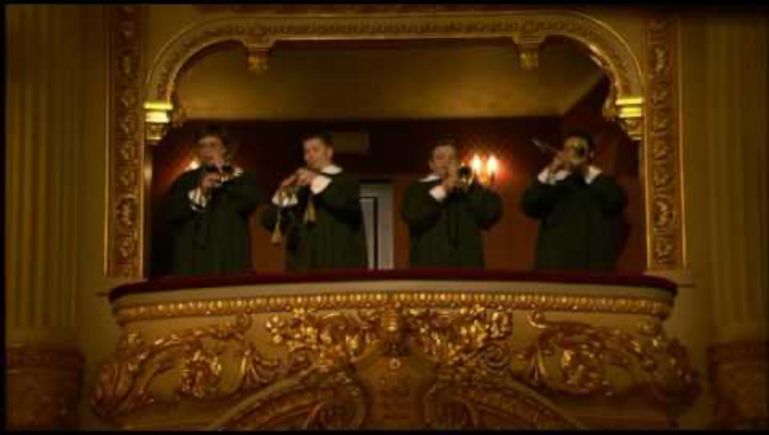
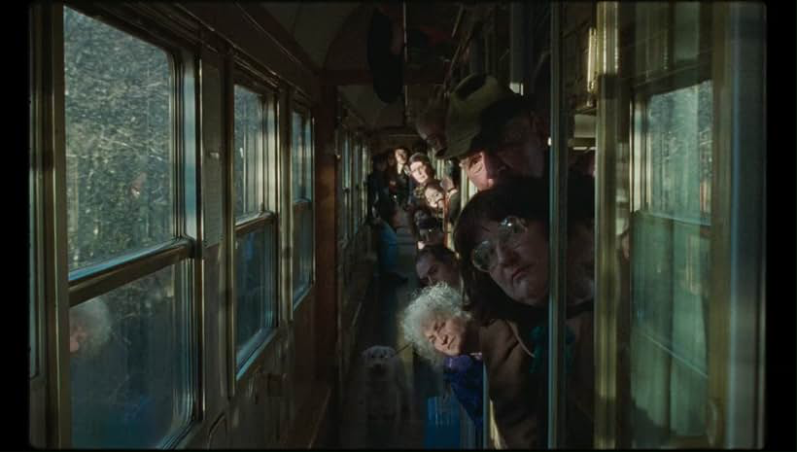
acknowledgement
Arthur peers down the train’s corridor, as the viewer hears the non-diegetic toccata fanfare from Monteverdi’s Orfeo.
Claudio Monteverdi (1567-1643), La Favola d’Orfeo. 1607. Opera (favola in musica). Libretto, Alessandro Striggio the Younger after Peri’s/Rinunccini’s Euridice (1600).
Premiered Feb 1607, Accademia degli Invaghiti, Mantua.
Jordi Savall conducts Le Concert des Nations, La Capella Reial de Catalunya at
Barcelona’s Gran Teatre del Liceu in 2002. DVD distributed by BBC Opus Arte. Fully uploaded on YouTube: https://youtu.be/mjpFi9bn1do?si=ziXaP90plKPc1grJ
6:15 — Prologue

Slide 4
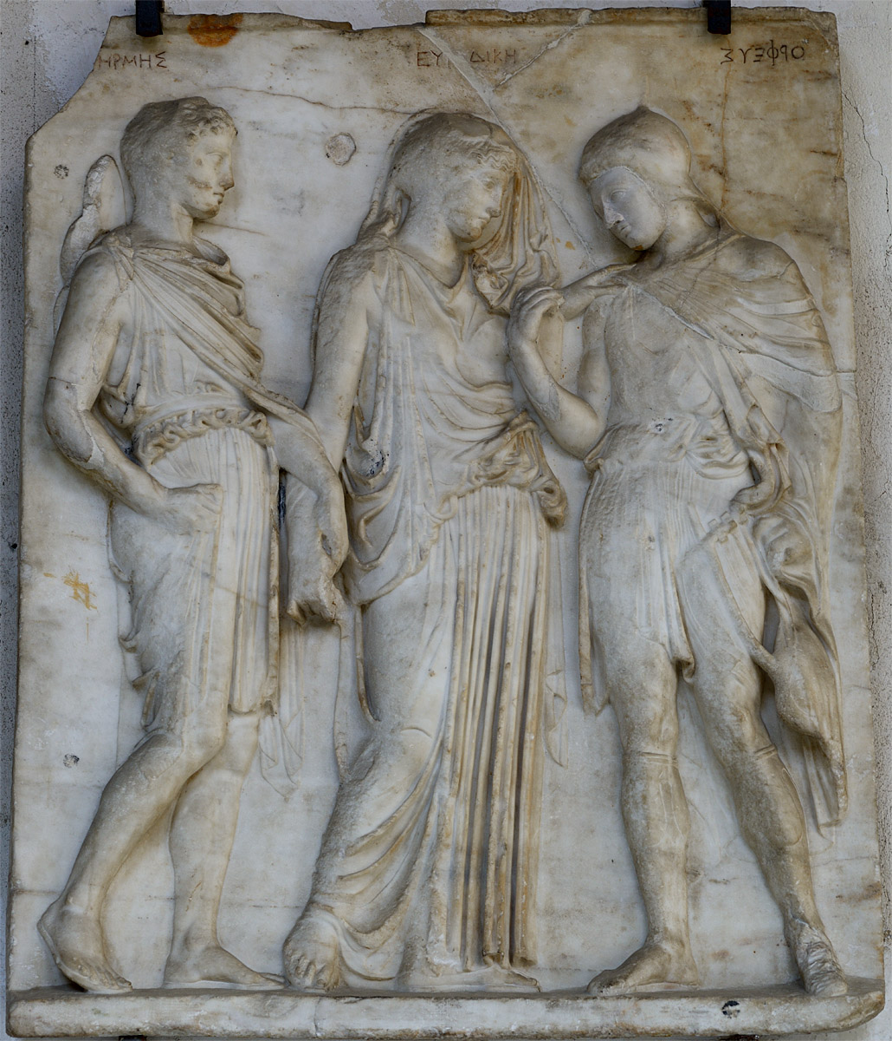
Hermes, Eurydice, Orpheus
1st Century BC after 5th Century Athenian relief
Museo Archeologico Nazionale di Napoli

Slide 5
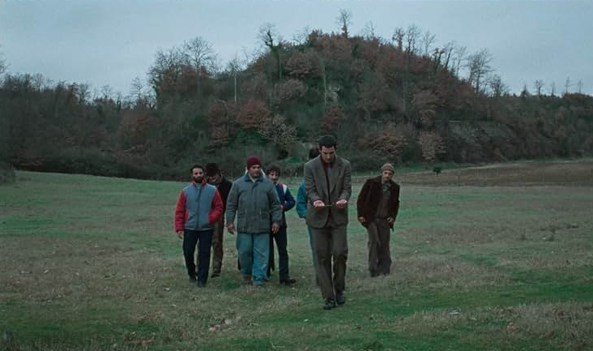
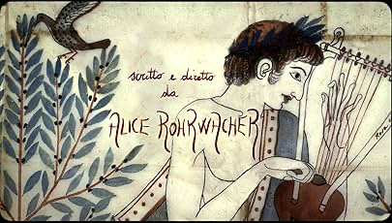
Orpheus divinely talented

Slide 6
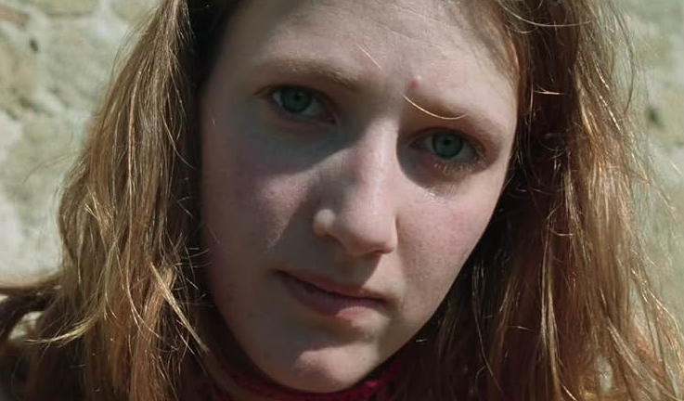
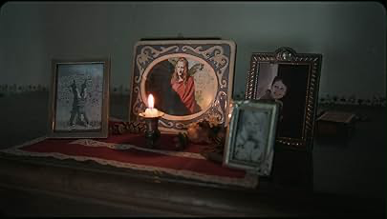
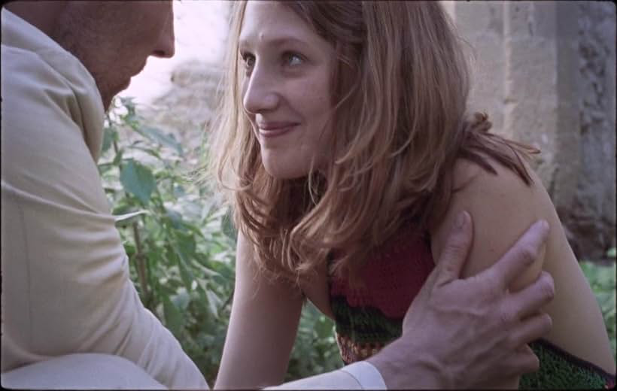
Eurydice prematurely lost…

Slide 7
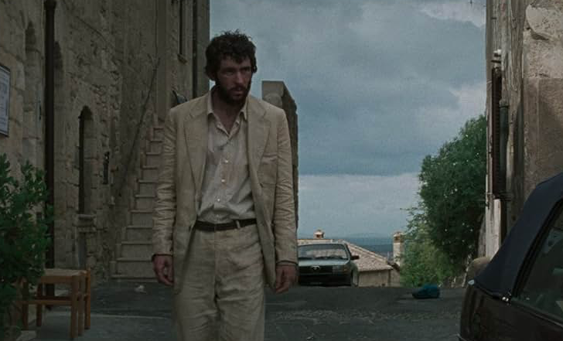
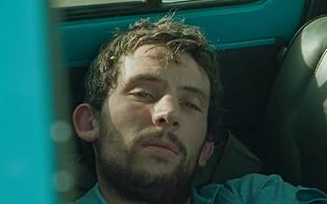
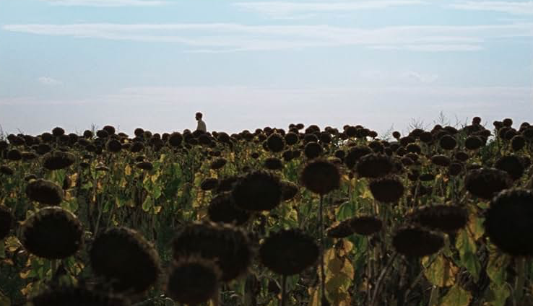
Orpheus inventor of elegiac poetry

Slide 8
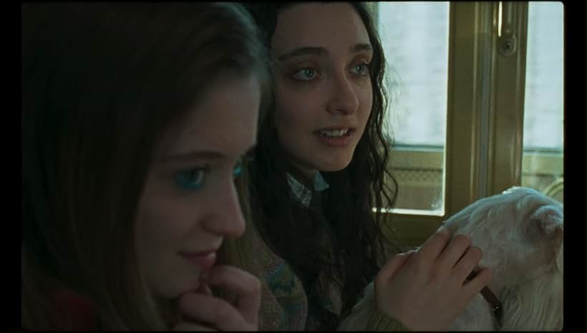
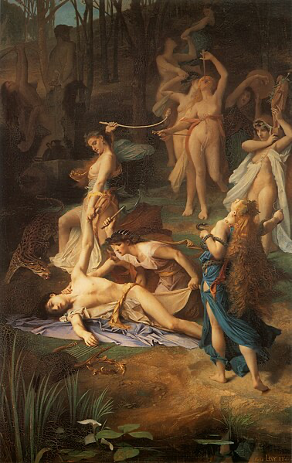
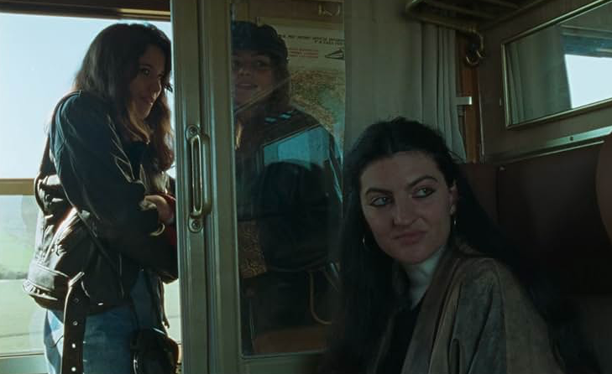
Orpheus destroyed by maenads
E. Lévy (1866)
Musée d’Orsay

Slide 9
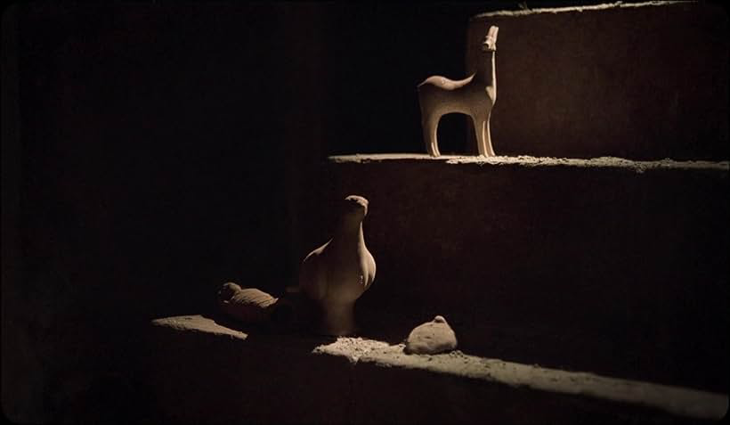
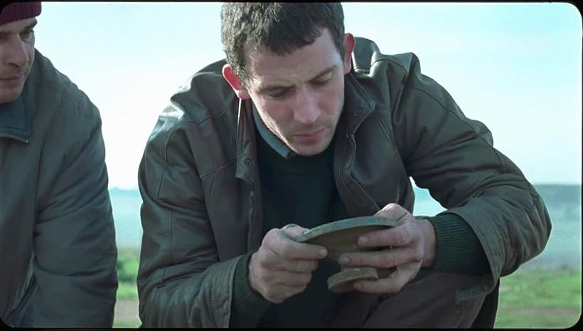
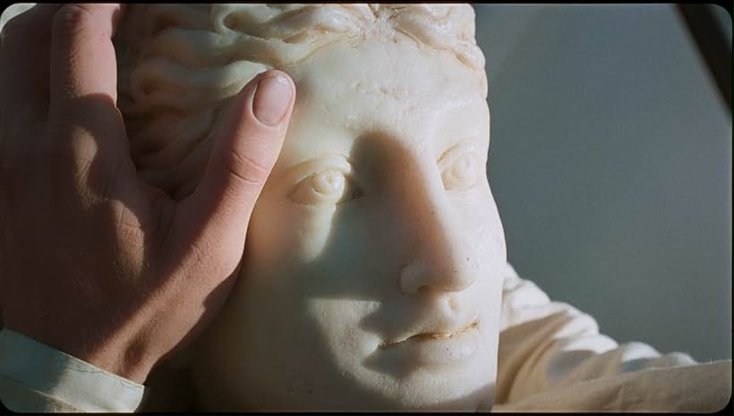
corredo gravegoods tombaroli grave-robbers

Slide 10

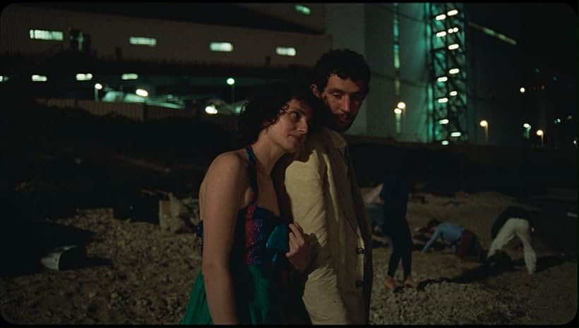
Italia a value-added bonus

Slide 11
