Slide 1
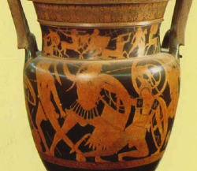
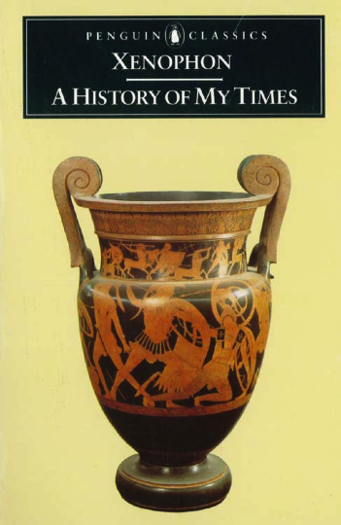
Agrigento, Red-figure amphora: combatants below, lapithocentauromachy above

