Slide 1
Adaptation of Classical Myth
“A difficulty we face in studying Greek myth is to separate the myth from the work of literature that embodies it. A focus on the myths alone would give us a bare-bones list of all the extant variations of, say, the story of Oedipus. A literary analysis, on the other hand, might concentrate on how Sophocles portrays character in the play Oedipus the King. [Or the same could be done with Sophocles’ Oedipus at Colonus… or Lee Breuer’s Gospel at Colonus… of Triana/Garcia Marquez’ Oedipo Alcalde, of P.D.Q. Bach’s Oedipus Tex, etc. etc.] “… The fate of myth [is] to be recast and reformed according to the needs of the day.” — Powell Classical Myth, 9e (OUP, 2021), 68 [w/ Macfarlane augment]
Slide modified by RTM

Slide 2

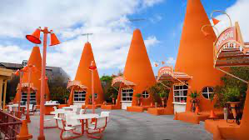



The concept of borrowed prestige
Pro-Title & Escrow, est. 1999, Provo, UT
Click here for Google Street view.

Slide 3
the prestige and ubiquity of Classical myth
“It is a myth of modern Greece (whether true or not) that its past confers prestige upon its present. It is a story that Greece tells itself about itself repeatedly, in different contexts, and to different audiences.” — Morales, Classical Mythology: vsi (OUP, 2007), 2
“Everyone who is alive to the … culture of today encounters it.” Morales 4

Slide 4
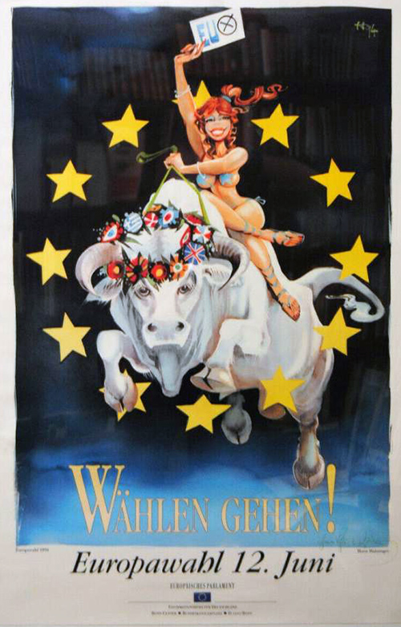
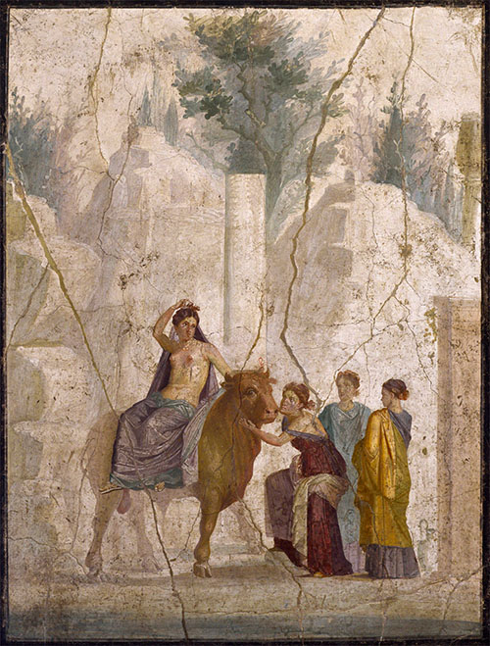
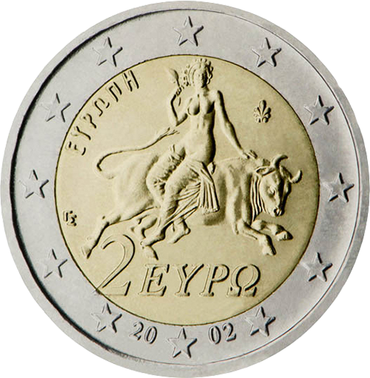
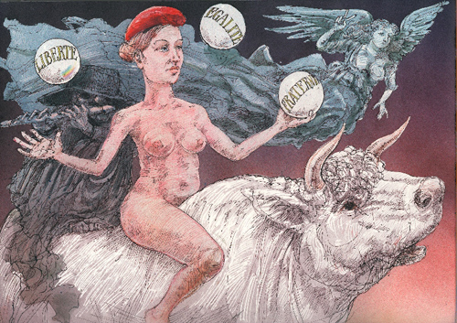
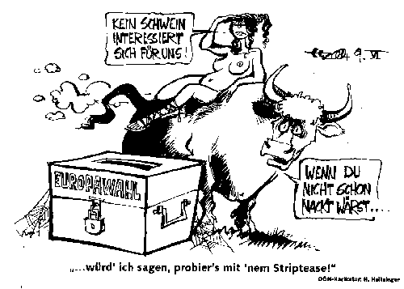


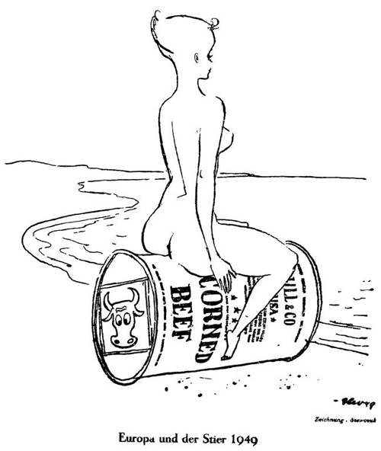
Europa and the Bull: a pedigree of classical antiquity
http://ogcma.byu.edu/Europa1.0000_Reid.htm
Europa2.0201_Haitzinger
EuropaANCIENT_HoraceC.3.27
EuropaANCIENT_Pompeii
Europa2.0002_Ehrt
Europa2.0001_Haitzinger
Europa2.0010_Stamatopoulos
Europa2.0005_Szewczuk
Europa2.0200_Haitzinger
Europa2.0003_Spiegel

Slide 5
Adaptation’s All About selection and suppression
“Myth is a complex game of production and reception that involves selecting some parts of a narrative and suppressing others.” — Morales p. 9

Slide 6
That ≠ WHY — the case of G. Swift’s Last Orders
Graham Swift’s Last Orders won the 1996 Booker Prize
John Flow objected that the novel “close similarities” to Faulkner’s As I Lay Dying (1939)
“… the provable line of influence from Faulkner rendered Swift’s book secondary … unworthy of the prize…”, or an act of plagiarization? (Sanders 43)
Sanders concludes (49) that Swift self-consciously appropriates Faulkner “to explore the topic of national identity and inheritance.”

Slide 7
That ≠ WHY — the case of G. Swift’s Last Orders
Graham Swift’s Last Orders won the 1996 Booker Prize
John Flow objected that the novel “close similarities” to Faulkner’s As I Lay Dying (1939)
“… the provable line of influence from Faulkner rendered Swift’s book secondary … unworthy of the prize…”, or an act of plagiarization? (Sanders 43)
Sanders considers and concludes that Swift self-consciously appropriates Faulkner “to explore the topic of national identity and inheritance.”

Slide 8
Adaptation vs Appropriation
“An adaptation most often signals a relationship with an information source text” (S 35)
“Appropriation frequently effects a more decisive journey away from the informing text into a wholly new cultural product and domain…” (S 35)
Romeo and Juliet (1597) West Side Story (1957) “adaptation in another mode or key” (S37) “a more wholesale redrafting, or indeed recrafting, of the intertext” (S38)
Taming of the Shrew (1590/1592) Kiss Me, Kate (1949) appropriation: “wider framework story of the US theatre performers and in the related subplot of the Mafia henchmen…” (S38)

Slide 9
“Second without being secondary” Hutcheon’s Theory of Adaptation
“’…an adaptation is derivation that is not derivative — a work that is second without being secondary’.
“A close reading of Swift’s richly textured and hyper-British narrative convinces me that the adaptive relationship [between Last Orders and As I Lay Dying] only heightens [LO’s] literary achievements and enhances its capacity to produce profound responses in the self-aware reader.”

