Slide 1
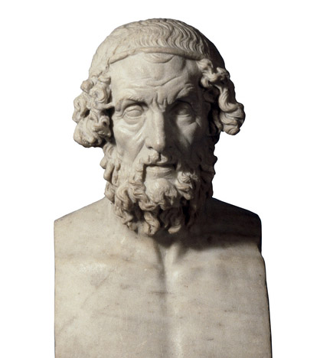
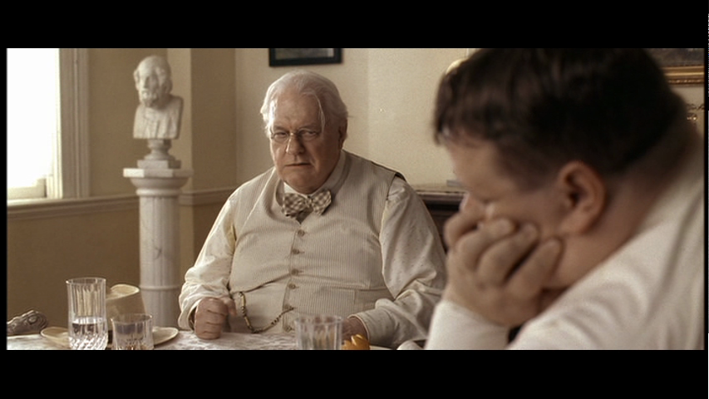
“The desire to experience, say, Homer in himself untouched by any taint of modernity is part of the pathology of many classicists, but it is a deluded desire.” Martindale
British Museum GR 1805.7-3.85 (Sculpture 1825),
AN34473001
O Brother, Where Art Thou?, dir. by J. Coen, Universal 2000

