Slide 1
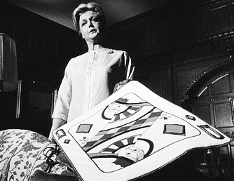
A Cold-War Oresteia
Richard Condon’s Eleanor Iselin, or his Manchurian Clytemnestra
Roger Macfarlane: BYU Classics
Notes:
Be cautious not to praise the film too much. It was a flop. ... Until its revival
“May be the most sophisticated political satire ever made” (Pauline Kael on the DVD cover)
Speak here about some of the great moments in the film:
the New Jersey Ladies Garden Club circular shot, a real stunner
the Heinz 57 ketchup botle
an artifact of cold-war angst
extra-cinematic importance in cultural studies: taken out of circulation after JFK assassination (1963 – 1988)
Angela Lansbury’s remarkable role
“Most people probably think of the movie as a classic of cold war culture, like Ôn the Beach or Invasion of the Body Snatchers a popular work articulating the anxieties of an era. In fact, The Manchurian Candidate was a flop. It was released in the fall of 1962, failed to recover its costs, and was pulled from distribution a year later, after the assassination of John F. Kennedy. It turned up a few times on television, but was not shown in a movie theater again until 1987, which -- nearly the end of the cold war – is the year from which its popularity dates.” louis menand

Slide 2
“I have conditioned them...or brainwashed them, which I understand is the new American term”
Dr. Yen Lo and 1950’s psychology
Yet among the film’s great cinematic moments:
“POW: The Fight Continues after the Battle” USArmy 1955
Conditioned Reflex Therapy, Andrew Slater 1949
Seduction of the Innocent, Fredric Wertham 1954
Thought Reform and the Psychology of Totalism: a study of ‘brainwashing’ in China, R.J. Lifton 1961
The circular pan-shot of Mrs. Whittaker's lecture "Fun With Hydrangeas"
Notes:
After looking at the books, ...
Also mention the pro-Lincoln hypocrisy of the Iselins, a gag that runs through the film.

Slide 3

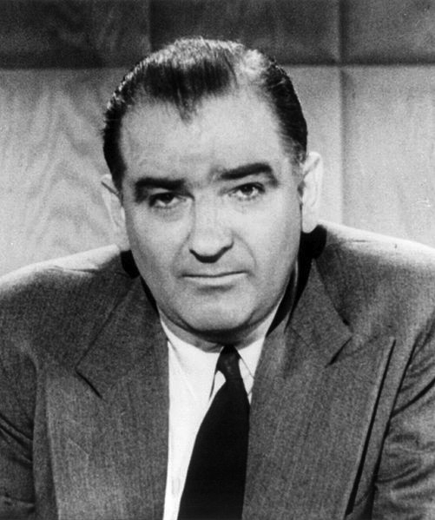
“There are precisely 57 communists in the US State Department.”
Joseph R. McCarthy (R-Wisconsin) and the “Second Red Scare”
9 Feb 1950 Speech to Republican Women’s Club of Wheeling, WV
1949 – 1954, 109 congressional investigations carried out
Notes:
Joseph McCarthy, speech to the Republican Women’s Club of Wheeling, WV, 9 Feb 1950: [Producing a piece of paper which he claimed contained a list of known Communists working for the State Department: “I have here in my hand a list of 205 – a list of names that were made known to the Secretary of State as being members of the Communist Part and who nevertheless are still working and shaping policy in the State Department.” R. Griffith, The Politics of Fear: Joseph R. McCarthy and the Senate. Umass Press 1970, p. 40.

Slide 4
“Pantless at Armageddon: review of Condon’s The Manchurian Candidate” Time 6 July 1959: 78
…an almost complete catalogue of humanity’s disorders, including incest, dope addiction, war, politics, brainwashing and multiple murder” — not to mention matricide — all spawned by one woman’s ambitions.
Notes:
Condon’s oresteia terrifies by playing on visceral fears of its time: “…an almost complete catalogue of humanity’s disorders, including incest, dope addiction, war, politics, brainwashing and multiple murder” — not to mention matricide — all spawned by one woman’s ambitions. That is pointed psychological terror.’

Slide 5
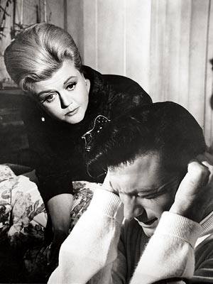
Axelrod’s screenplay retains definitive, thematic likeness from Condon’s novel.
In the Frankenheimer film, the first overt reference comes at minute 105, when Bennett and Raymond are good and drunk.
  Shaw: “My mother is a terrible, terrible woman. ... Oh, but you don’t want to hear about my mother.”
  Marco: “I’m interested. It’s rather like listening to Orestes gripe about Clytemnestra.”
In the Condon novel, the references to Aeschylus’ Oresteia begin earlier and with more apparatus.
  p. 22 f. “Marco always encouraged Sgt. Shaw to tell him [stories about his life] when they were on patrol. ... The captain liked to hear the story because...it was like hearing Orestes gripe about Clytemnestra. ... He was a reader.”
  p. 24 “Raymond...had large glaucous eyes with very large whites, like those of a carousel horse pursued by the Erinyes, those female avengers of antiquity.”
Notes:
“Captain Marco treasured poetic, literary, informational, and cross-referenced allusions, military and non-military. He was a reader.”

Slide 6
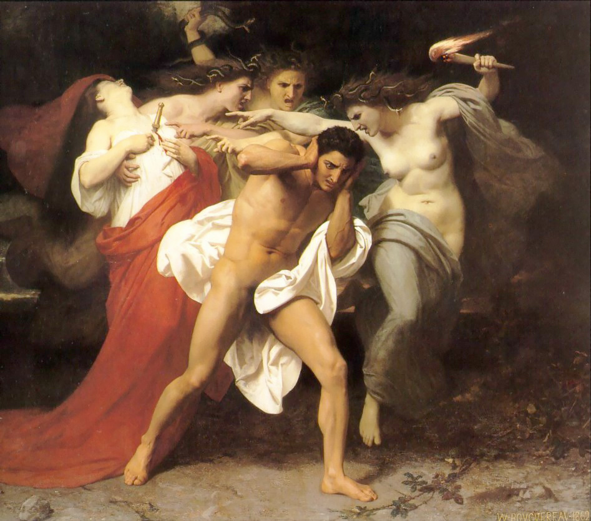
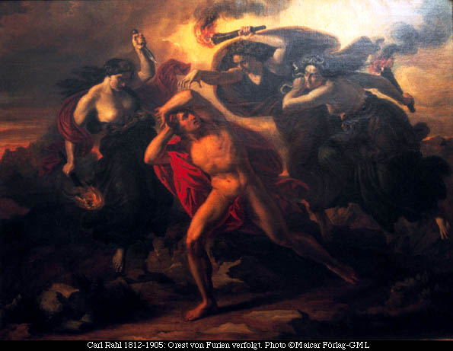
Orestes Pursued by the Furies
Carl Rahl, 1865
William Adolphe Bouguereau, 1862

Slide 7
The oresteia: key character correspondences
The Oresteia
Furies/Erinyes antedate all.
(Hesiod, Theogony)
Agamemnon leads Greeks to Troy.
Clytemnestra kills Agamemnon upon his return to Argos.
Motives vary:
Iphigenia or Aegisthus
Orestes must avenge his father’s murder ...
... and matricide brings Furies.
The Manchurian Candidate
Raymond’s mother cherishes recollection of her abuse ...
... divorced Mr. Shaw when 6 months pregnant and shortly before his mysterious death.
Eleanor Shaw Iselin wields consummate political power.
She promotes her — or, is it her new husband’s? — career at all costs.
Her son, Raymond Shaw, must do as he’s told...
... building narrative suspense.

Slide 8
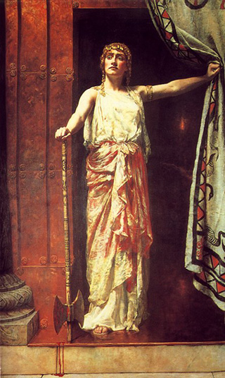
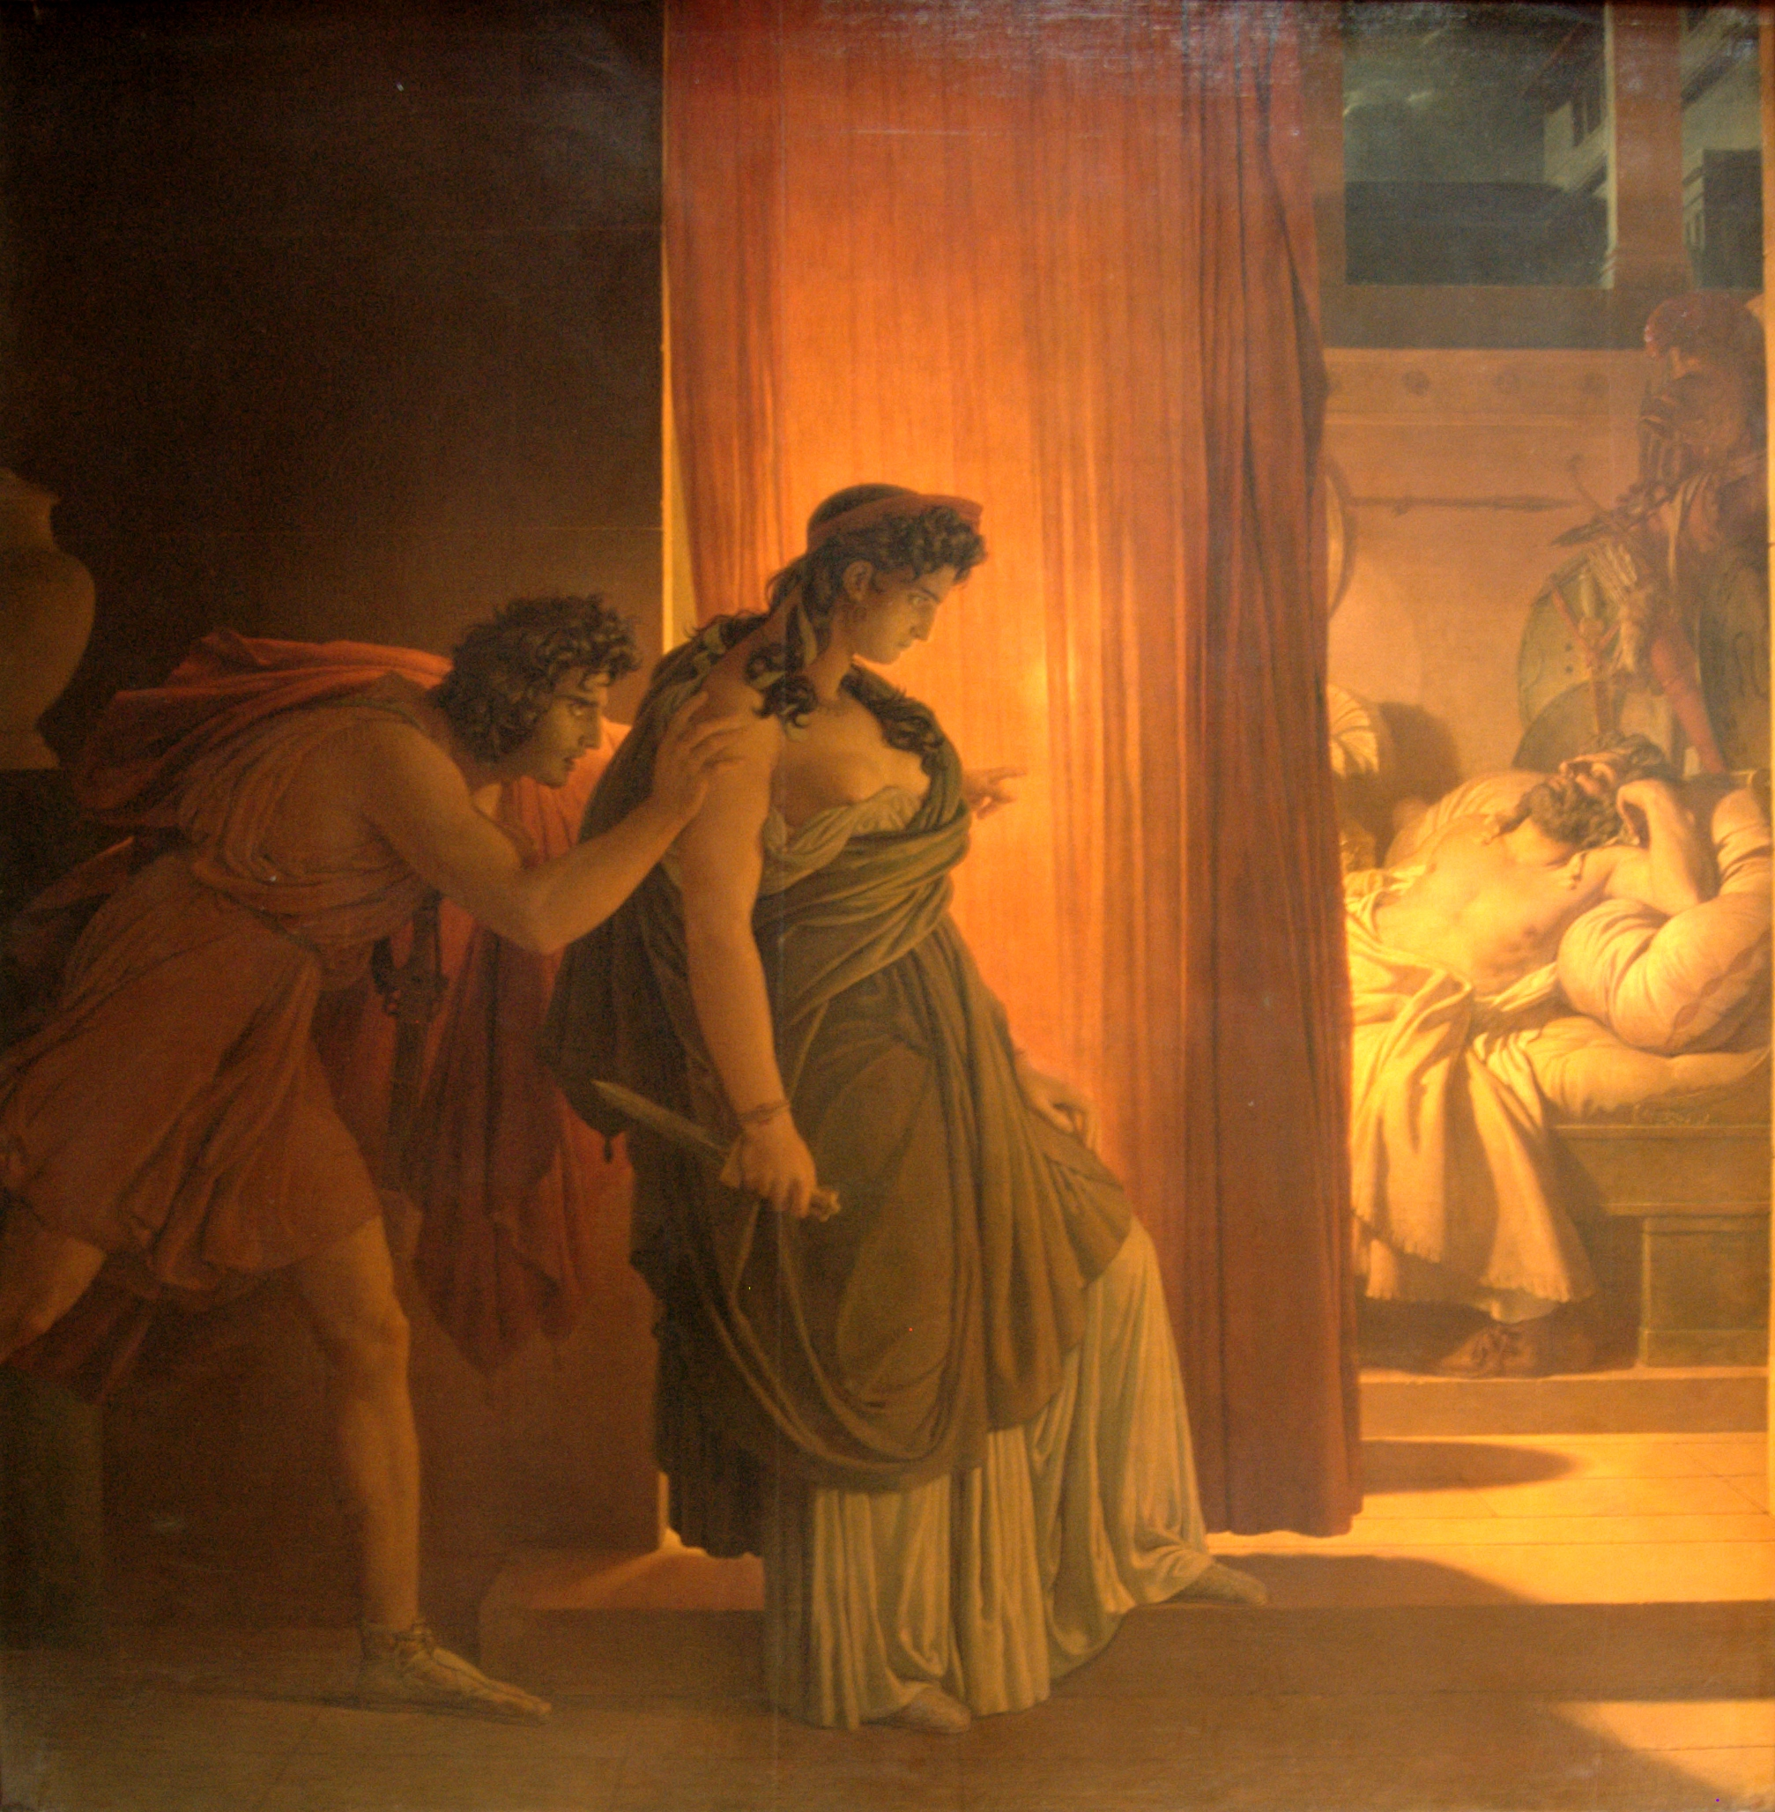
P.N. Guerin, “Clytemnestra with Aegisthus” 1817
Clytemnestra ... and/and not Aegisthus
J.M. Collier, “Clytemnestra” 1897

Slide 9
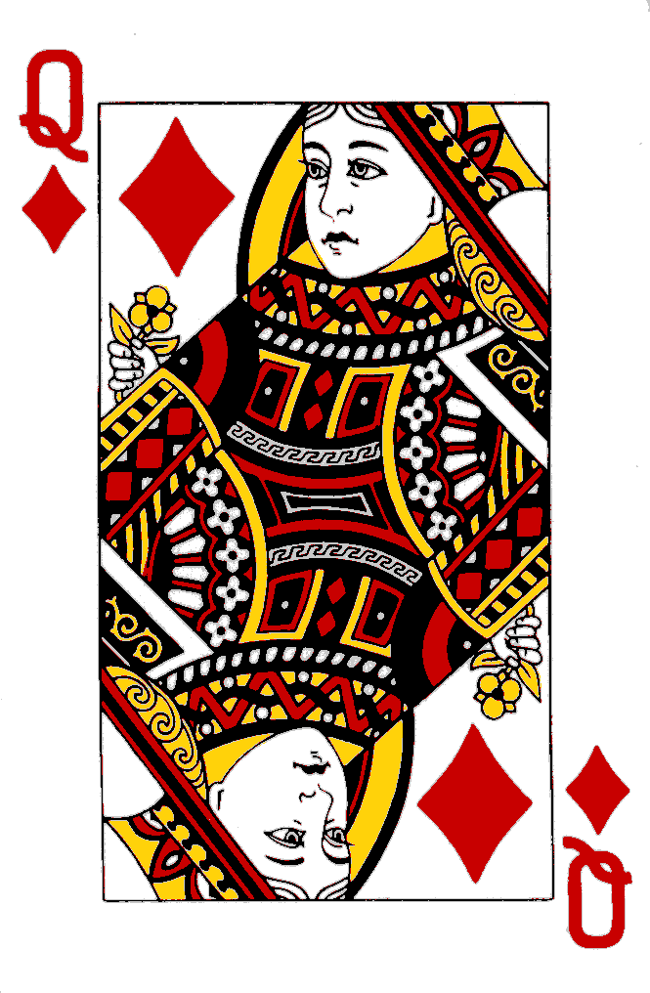
Why don’t you pass the time by playing a little solitaire?
“The queen of diamonds is a woman [of] intense and passionate temperament ... [who] always gets what she wants.”
M. Jones, It’s in the Cards: find your future in any deck of cards (Boston: Weiser 1984), 174.
Notes:
In the novel and in the film, the Red Queen is a fitting symbol for this frightening aberration of maternity and patriotism run amok. Aside from its symbolism as the traditional face-card, the symbol invokes the spectre of “RED” Communism in the wickedness of Raymond’s mother. She sidles up to her brainwashed child and coos “Just as I am a mother before everything else, I am an American second to that.” Spoken by an American mother in revealing Chinese silk, this repulsive pledge of allegiance echoes the void between winsome virtue and prostitute treason. Raymond’s mother ‘operates in a constellation of Cold War images’ and distorts ideals of American feminism, proper motherhood, and the healthy family as ‘the American way of life.” The society that fabricated Donna Reed and June Cleaver must recoil at the brazen ambition of Raymond’s mother. For similar reasons Aeschylus’ Argive elders shuddered as their queen’s plans became clear, too late.

Slide 10
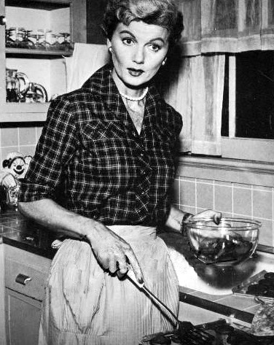
“Just as I am a mother before everything else, I am an American second to that.”
“Overweening American ‘momism’ ... threatens to weaken an entire generation of American boys and open a path of communist progress.”
-- P. Wylie A Genertioin of Vipers: a survey of moral want (New York: Farrar & Reinhart, 1942) 204.
Barbara Billingsley as June Cleaver, “Leave it to Beaver”
1957 – 1963 (mostly on ABC)
Notes:
In the novel and in the film, the Red Queen is a fitting symbol for this frightening aberration of maternity and patriotism run amok. Aside from its symbolism as the traditional face-card, the symbol invokes the spectre of “RED” Communism in the wickedness of Raymond’s mother. She sidles up to her brainwashed child and coos “Just as I am a mother before everything else, I am an American second to that.” Spoken by an American mother in revealing Chinese silk, this repulsive pledge of allegiance echoes the void between winsome virtue and prostitute treason. Raymond’s mother ‘operates in a constellation of Cold War images’ and distorts ideals of American feminism, proper motherhood, and the healthy family as ‘the American way of life.” The society that fabricated Donna Reed and June Cleaver must recoil at the brazen ambition of Raymond’s mother. For similar reasons Aeschylus’ Argive elders shuddered as their queen’s plans became clear, too late.

Slide 11

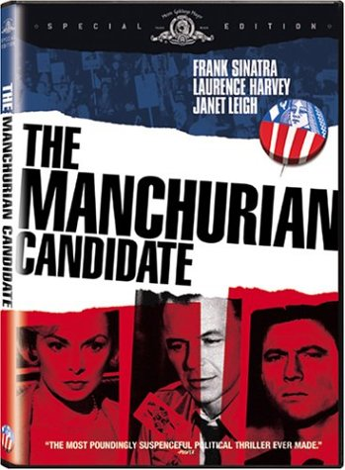
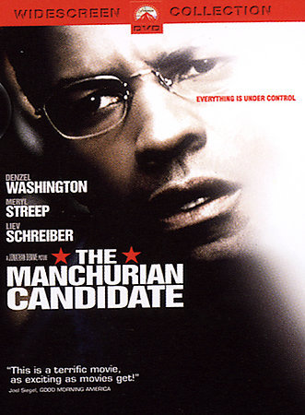
How strong is the limb?
R. Condon, 1959
Dir. J. Frankenheimer, MGM 1962
Dir. J. Demme, Paramount 2004
Thematic use of Orestes theme.... diminished but present in film.
No residual awareness of Orestes theme.
Notes:
1987 reprint, MGM DVD cover, 2004 Paramount DVD cover

