Slide 1
un-Homeric Howlers

Slide 2
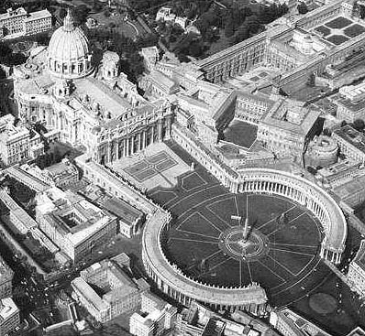
Bernini’s Piazza di San Pietro … in Thebes?!?!?!
minute 14:26 or so

Slide 3
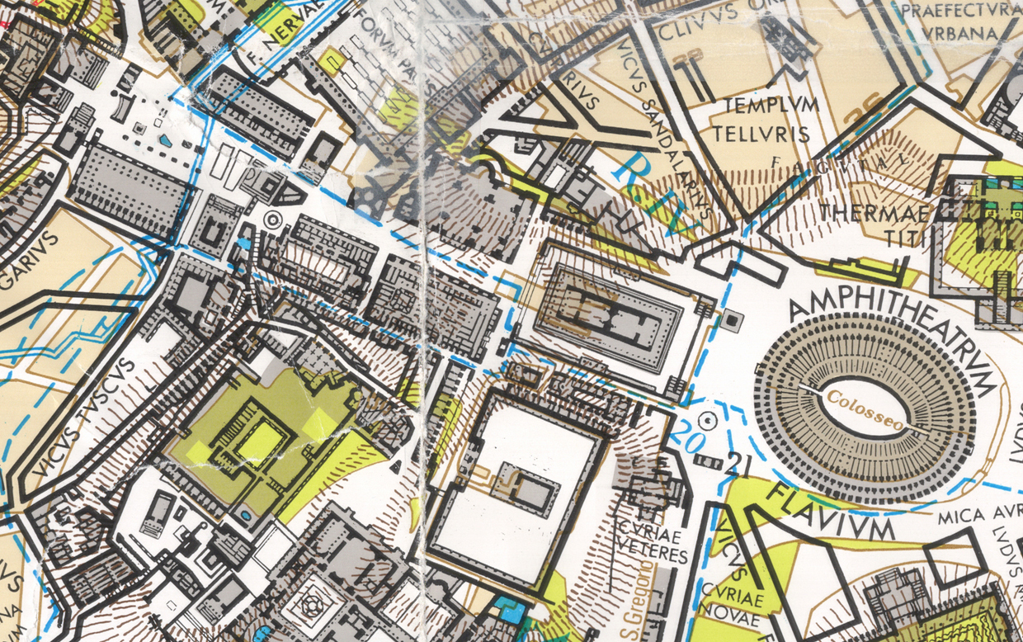
An impossible view through the Forum Romanum, Gladiator 59:58

Slide 4
Ut Roma Cadit, Ita Orbis Terrae
Gladiator 1:18:06 or so
M. Dubuisson, “Gladiator: le point de vue de l’historien” : Même s’il reste quelques erreurs et quelques imprécisions (quitte à fabriquer une inscription amusante, autant le faire en latin correct et dire terrarum…), j’ai noté avec satisfaction, par example, la disparition des gestes pseudo-romains introduits par les Américains dans l’entre-deux-guerres (le poing frappant la poitrine commme équivalent de salut militaire…) ou encore l’absence de toute scène d’<<orgie>>.”

Slide 7
Solomon on “Viewing Troy”
“[Classicists go to such films as Troy, and] When the viewing is finished, the classicist may expect a barrage of questions from students, colleagues, family, and even the press and ultimately may be asked for a ‘thumbs up’ or ‘thumbs down’ judgment about the film’s merit. With all its mistakes and oddities, can such a film be shown in class? “This is no way to watch a movie!”

Slide 8
Solomon on “Viewing Troy”, II
“Viewing circumstances can be even less suitable. Films like Troy, Oliver Stone’s Alexander (2004), or Ridley Scott’s Gladiator (2000) have such high-profile releases that a number of classicists attended premieres or early showings, sitting bundled together in small groups. Some may be pondering what this or that colleague knows or is thinking that they themselves do not. Professional prestige and even competition come into play, and if a junior faculty member attends a showing with a senior, the former’s career is a consideration. A similar mindset will also interfere with a teacher who views one of these films with students who will expect from the scholar to know everything about the film’s historicity and authenticity.
“This is no way to watch a movie.”

Slide 9
Dio Chrysostom Disc. 11.95-96 and 123-24
And so it had become clear to Hector, a master in the art of war, that in view of all these conditions Achilles was an easy prey. Accordingly he boldly confronted him in the open plain. At first he gave way as if in open flight, but with the real purpose of testing him and, at the same time, wearying him by now making a stand and now fleeing. Then when he noted that he lagged and fell behind, he himself turned and fell upon Achilles, who was no longer able even to support his arms. He gave him battle, slew him, and, just as Homer has told it,³ possessed himself of his arms. He pursued the horses of Achilles too,” said the Egyptian priest, “but he did not bring them in though they too were caught. The two Ajaxes with great difficulty managed to bring back the body of Achilles to the ships; for the Trojans, now feeling relieved and believing that they were victorious, were pressing on with less energy; while Hector, after donning the emblazoned arms of Achilles, continued the slaughter and pressed on in pursuit to the sea, just as Homer admits. Night fell, however, and prevented the burning of all the ships.
http://www.loebclassics.com/view/dio_chrysostom-discourses_11_trojan_discourse/1932/pb_LCL257.519.xml?result=11&rskey=SZO1UZ
DOI: 10.4159/DLCL.dio_chrysostom-discourses_11_trojan_discourse.1932

Slide 10
Philostratus of Athens, Heroicus
The ghost of Protesilaus, the first Greek killed during the landing at Troy, informs Philostratus’ narrative.

Slide 11
Dictys of Crete
reputed companion of Idomeneus
alleged author of an account of Trojan War
P.Tebt. 2.268, frag. Greek, 2nd/3rd ct. AD
the Ephemeris Belli Troiani, 4th century AD
the primary source for matter Troiae through un-Greeked Middle Ages

Slide 12
Dares of Phrygia
Trojan priest of Hephaestus, Il. 5.9
supposed author of pre-Homeric De excidio Troiae historia (Ael. VH 11.2) [actually 5th AD]
“undistinguished and derivative, but … much read in the Middle Ages” SJHa in OCD
“Everything written about Troy before the middle of the 17th cent. was to some extent dependent, directly or indirectly, on the narratives of Dares and Dictys.” Drabble Companion

Slide 13
Petersen’s Troy
“Inspired by Homer’s Iliad.” closing credits Troy (2004)
compare to Simon Armitage’s The Last Days of Troy (stageplay, 2014)

Slide 14
Petersen’s Troy
“Inspired by Homer’s Iliad.” closing credits Troy (2004)
Prompt: Jon Solomon concludes an essay about the authencity of Petersen’s Troy that his “purpose in the preceding pages is not to limit debate but quite the opposite, to open up … discussion by directing our attention away from the accusation of inauthenticity, an easy default mode of criticism, to a more appropriate and sophisticated kind of judgment.”
Where do YOU think criticism [not always a negative enterprise] of Petersen’s film might most appropriately be directed?

Slide 15
Hom. Il. 1.94-96
[Calchas] took heart and this time he spoke out, bravely: “Beware — [Apollo] casts no blame for a vow we failed, a sacrifice. The god’s enraged because Agamemnon spurned his priest, he refused to free his daughter, he refused the ransom. That’s why the Archer sends us pains and he will send us more and never drive this shameful destruction from the Argives, not till we give back the girl with sparkling eyes to her loving father — no price, no ransom paid — and carry a sacred hundred bulls to Chryse town.” (Fagles 1.109ff.)

Slide 16
Four Key [to M] scenes
Achilles & Briseis get together
Death of Menelaus
Death of Patroclus
Ransoming of Hector’s body
You jot yours down right now. We’ll get to some.

