Slide 1
Cacoyannis Κακογιαννις Euripides’ Troades

Slide 2
Cacoyannis’ “Director’s Note”
The 1971 production of Troades prompted the director to write a brief statement on his adaptation of Euripides’ 415 BC tragedy.
The one-page note is included in the Kino Video (2004) DVD edition and dated simply “Paris, May 1971”.
Full .pdf of the note is available at (click here) http://cal.byu.edu/macfarlane/OGCMA/1053NOTTrojanWarFall_CacoyannisNOTE.pdf

Slide 3
from Cacoyannis’ “director’s note”
cinematic realism vs. “academic parodies” of stage productions that emphasize the age and distance between our narratives and classical tragedy
perhaps Cacoyannis means such productions at Tyrone Guthrie’s Oedipus the King (1957)—click here for a youtube. (cf. Mythmatters)

Slide 4
from Cacoyannis’ “director’s note”
Cacoyannis’ (1922 – 2011) filmography/c.v. shows developing affinity for Euripides, leads to observations on “narrative gain”, among many others
Elektra (1962)
Zorba the Greek (1964)
1964 reads Edith Hamilton’s Troades translation
and stages Troades at NY Circle-in-the-Square Theater
[1964 & 1966 military Juntas under ASPIDA and IDEA which pertains through G. Papadopoulos 1973 & beyond]
1968 stages Iph. Aul. in NY
1971 directs Troades for cinema
1978 directs Iphigenia [at Aulis] (1977; MGM)
FOR full career details, vid. Cacoyannis Foundation’s website (www.mcf.gr)

Slide 5
critique of Cacoyannis’ Euripides-crush
“There is a tendency to applaud Mr. Cacoyannis’ thoroughly ponderous attempts to make the ancient Euripidean tragedies comprehensible to contemporary movie audiences. We are asked to believe that the playwright and the film maker share some sort of deep cultural bond, as if they’d been in the same class at Athens High. Good old Mike and Rip — the Mutt and Jeff of the Acropolis.” Vincent Canby, NYT review of Iphigenia 21 Nov 1977

Slide 6
critique of Cacoyannis’ IA (continued)
“In ‘Iphigenia,’ as in ‘The Trojan Women,’ Mr. Cacoyannis employs all sorts of comparatively snappy film techniques—the handheld camera, the zoom lens, and the subjective camera by which we look out through the eyes of the character—to make us believe that we are there. It never works and can't work. We're not meant to get inside these characters, but to stand aside and observe the spectacle as a single, headlong ritual.” Vincent Canby, NYT review of Iphigenia 21 Nov 1977

Slide 7
Cacoyannis’ reading of Euripides Troades (415 B.C.)
appalled by Athenian massacre at Melos, 416/415
Thucydides’ Melian Dialogue, 5.84 – 111 (cf. 116): “… Right … is only a question between equals in power, while the strong do what they can and the weak suffer what they must.” (89, trans. by R. Strassler) click for Perseus site
“[E.] is an intellectual dramatist and his career has a curiously modern look... a profound explorer of human psychology… anti-war dramatist par excellence [featuring] attacks on Athenian imperialism.” — P. Easterling

Slide 8
Cacoyannis’ truncation of Troades
Euripidean prologue spoken by Poseidon and Athena, then the gods exeunt at line 97, never to return. Athena especially wreaks havoc to punish human disrespect for her divinity.
Euripidean chorus has typical presence in the stage play, with 386 lines of choral odes or threnody with characters.
Helen’s Bath occupies narrative space of 2nd Stasimon (a hymn to Eros)
Hecuba seizes stage from Menelaus 860ff. (next)

Slide 9
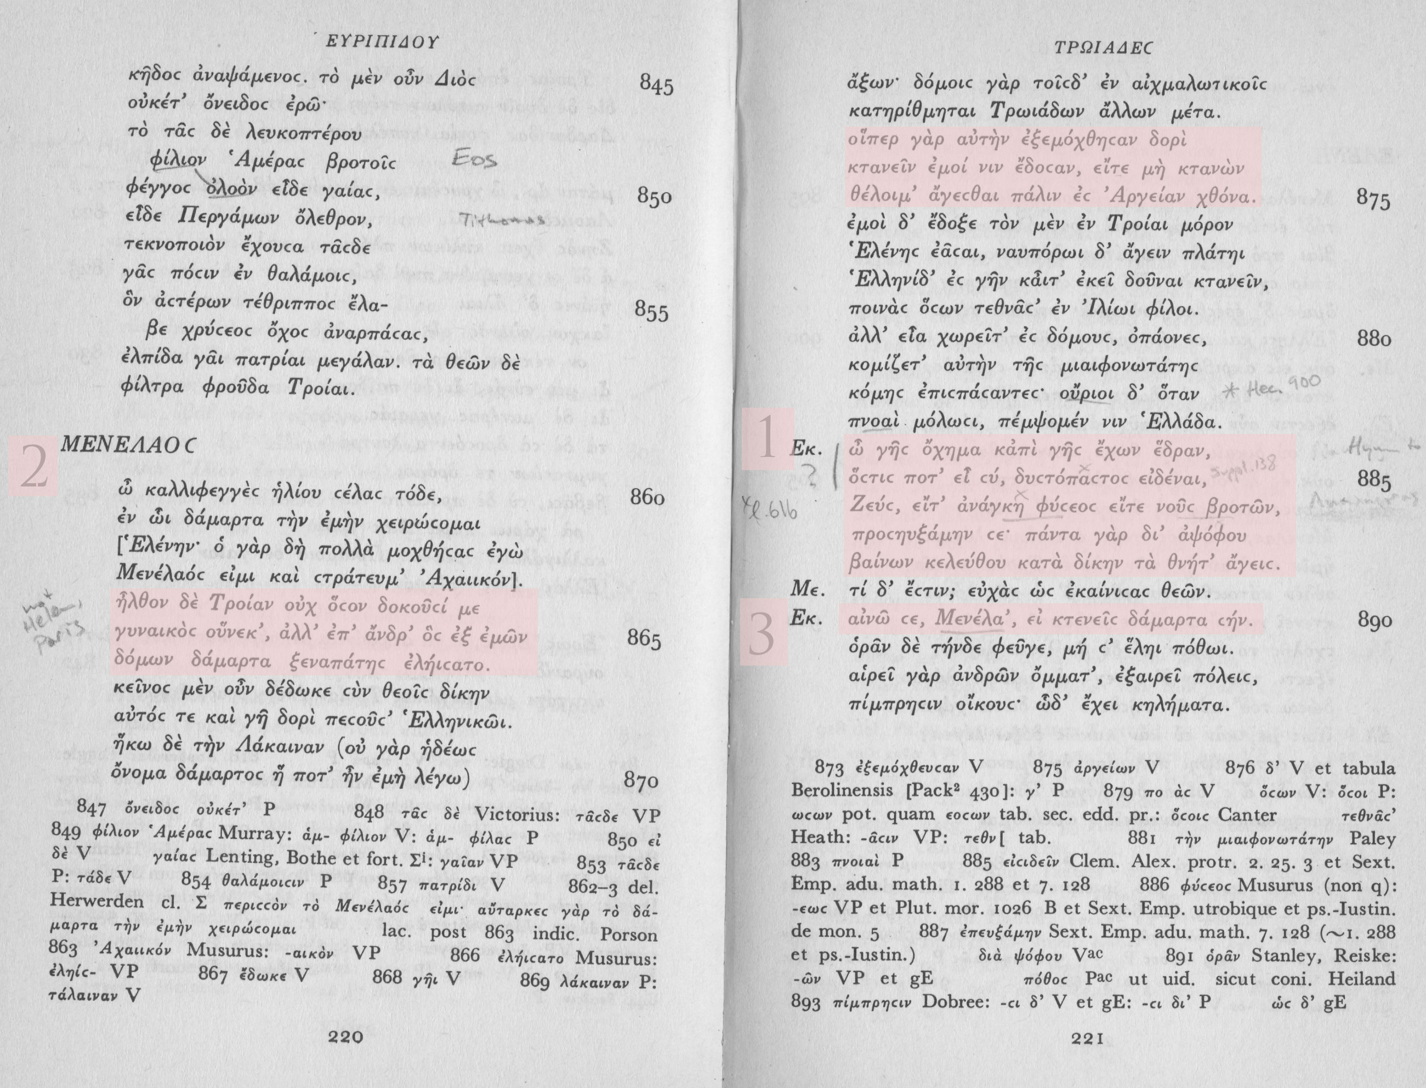
Cacoyannis’ screenplay changes sequence and truncates content of Euripides’ text

Slide 10
the prompt
Michael Cacoyannis stated his intention of achieving in his Trojan Women a certain realism that might transcend the stage-bound milieu of Euripides’ play. Cacoyannis praises Euripides for his achievement of tragic realism. He was interested in “lifting [the Euripidean adaptation] out of the bastard status of ‘filmed theatre,’ and integrat[ing] the text into the visual reality of cinema in the most economical and emotionally effective way possible.” Part of this cinematic adaptation involved some cutting or transposing of the playwright’s dialogue; but also cutting and close-up play an overt function throughout.
Consider where the director succeeds/strives especially in making the efforts of Hepburn and Redgrave and Bujold seem like the sufferings of Hecuba and Andromache and Cassandra? Do you believe the conversion of Talthybios? Is Astyanax’ death gut-wrenching? Is Helen’s plausibility due to Euripides’ craft or to Cacoyannis?
Share your evaluation of Cacoyannis’ success in The Trojan Women as far as REALISM is sought in the making of this film.

